Slide 1


Slide 3
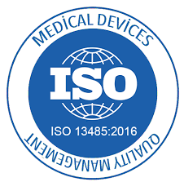

Slide 4
There is an unmet need for a continuous, long-term (28+ days), ambulatory, non-invasive medical device for monitoring of heart arrhythmias, vitals, and chronic diseases (e.g. COPD, Heart Failure, Sleep Apnea).
CardiacSense is a dynamic digital health company that has developed best-in class, wearable sensor technology with the sensitivity and specificity required for medical diagnosis and monitoring.
The company’s initial focus is on monitoring and detection of atrial fibrillation (AF), as well as other arrhythmias and vital signs such as blood pressure (BP), respiratory rate, and oxygen saturation.
Successfully completed clinical trials for AF detection by PPG and/or ECG were submitted for CE approval (expected in January 2021) and are pending for FDA/NMPA clearance (late 2021).
With initial sales contracts (totaling $72M), the company is looking for financing and potential partners to help bring this truly disruptive technology to market. We are seeking to raise $30M of funding to support this game plan as a pre-IPO round.
Executive Summary
3
Notes:
If we Successfully completed clinical trials for AF detection – why do we need them? Mention the case

Slide 5
Indication | Economic Costs* | of which… Medical Costs | Sources
 | 48 | 37 | www.ahajournals.org/doi/10.1161/CIRCOUTCOMES.110.958165 www.silverbook.org/fact/distribution-of-inpatient-and-selected-outpatient-costs-for-treating-atrial-fibrillation/
 | 47 | 42 | www.chestnet.org/News/Press-Releases%20/2014/07/CDC-reports-36-billion-in-annual%20financial-cost-of-COPD-in-US www.cdc.gov/copd/infographics/copd-costs.html
 | 39 | 26 | www.ahajournals.org/doi/10.1161/CIRCHEARTFAILURE.117.004873
 | 195 | 57 | aasm.org/resources/pdf/sleep-apnea-economic-crisis.pdf
 | 181 | 146 | www.ahajournals.org/doi/10.1161/JAHA.118.008731 www.cdc.gov/chronicdisease/programs-impact/pop/high-blood-pressure.htm
Total | $510B | $308B
US Annual Economic Burden
Costs in 2020 $B
Atrial Fibrillation
Chronic Obstructive Pulmonary Disease
Atrial
Congestive
Heart Failure
Sleep Apnea
Hypertension
All figures are adjusted for inflation in 2020 dollars using the medical care inflation calculator:
www.in2013dollars.com/Medical-care/price-inflation/2008-to-2020?amount=1000
* Comprises medical costs and societal costs (lost productivity, work accidents, driving accidents, etc.)
4

Slide 6
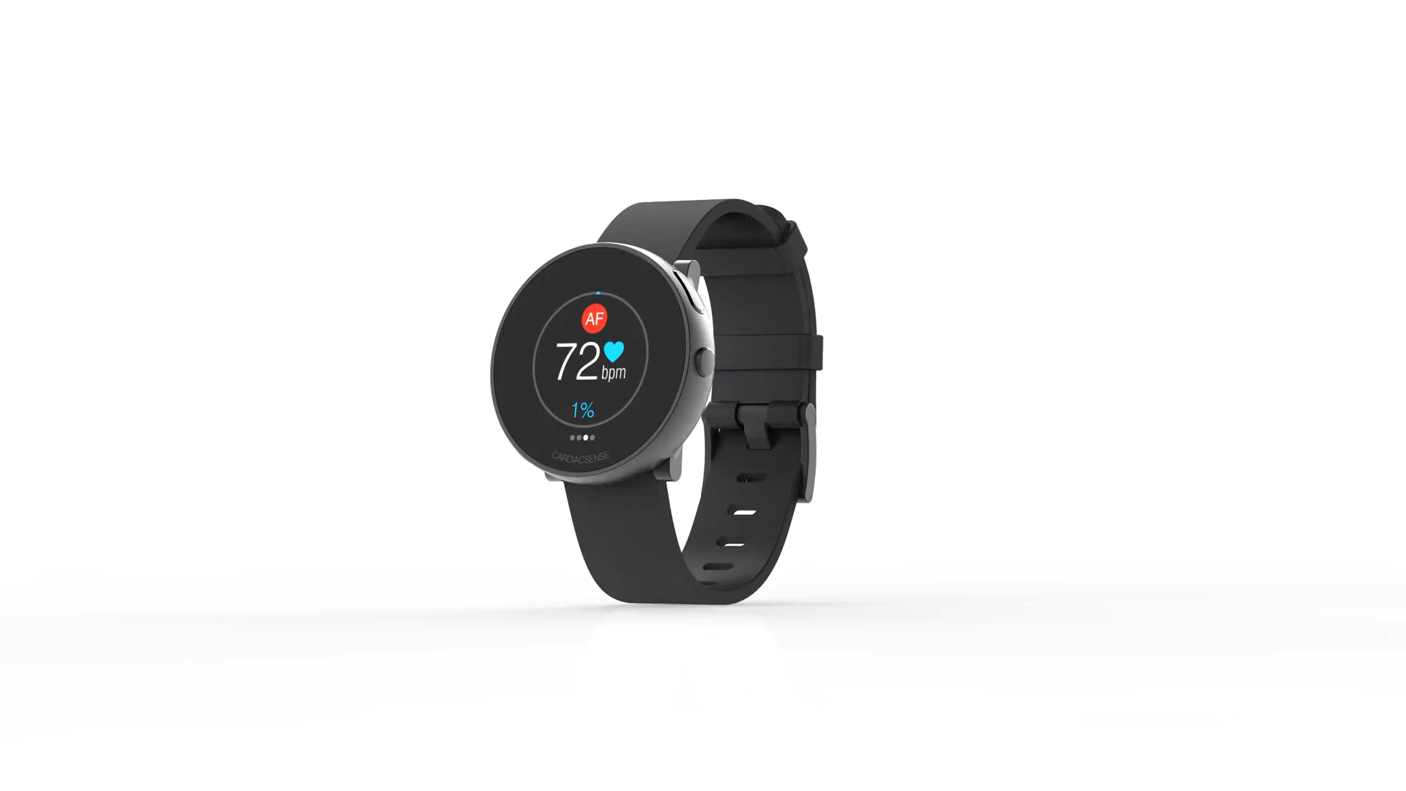
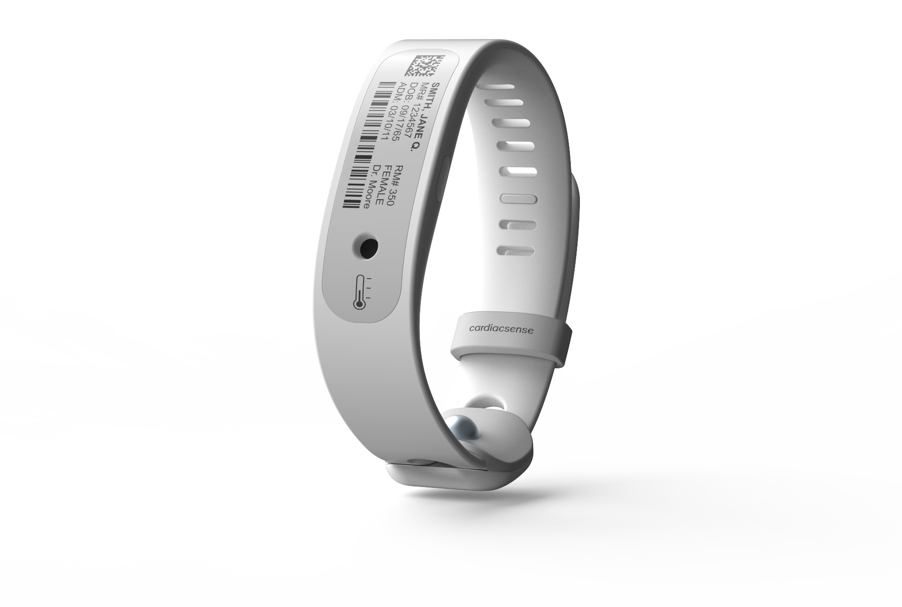
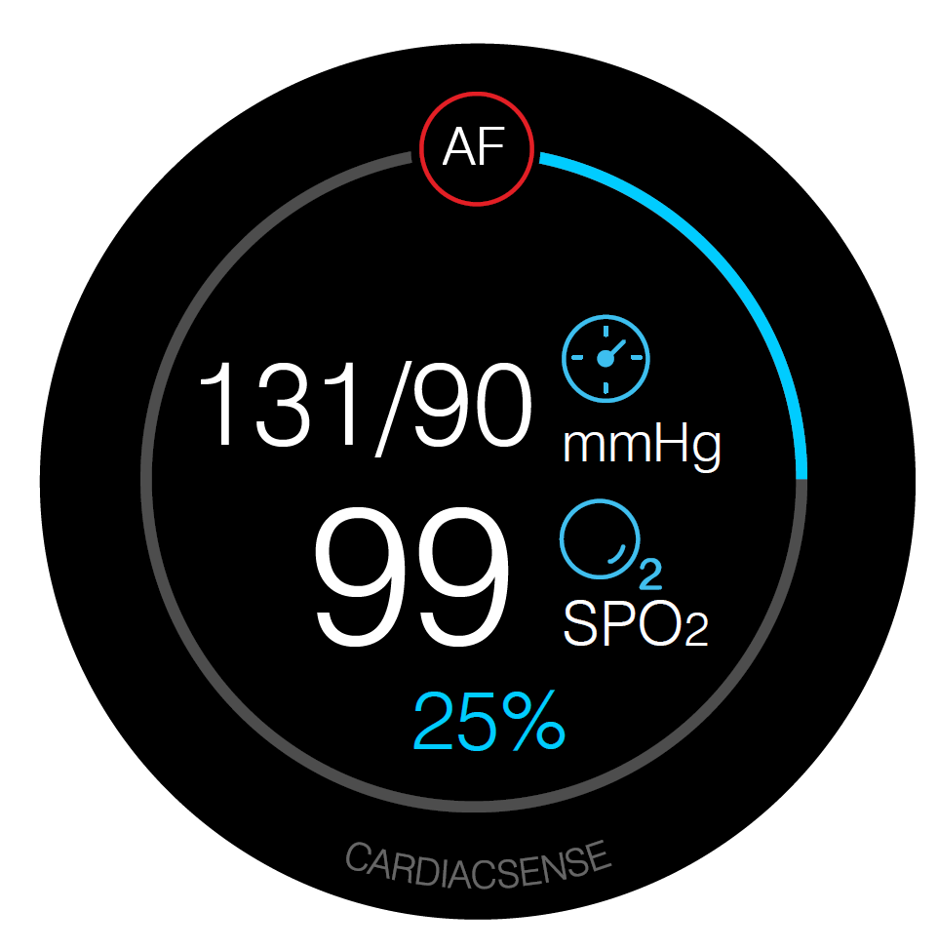
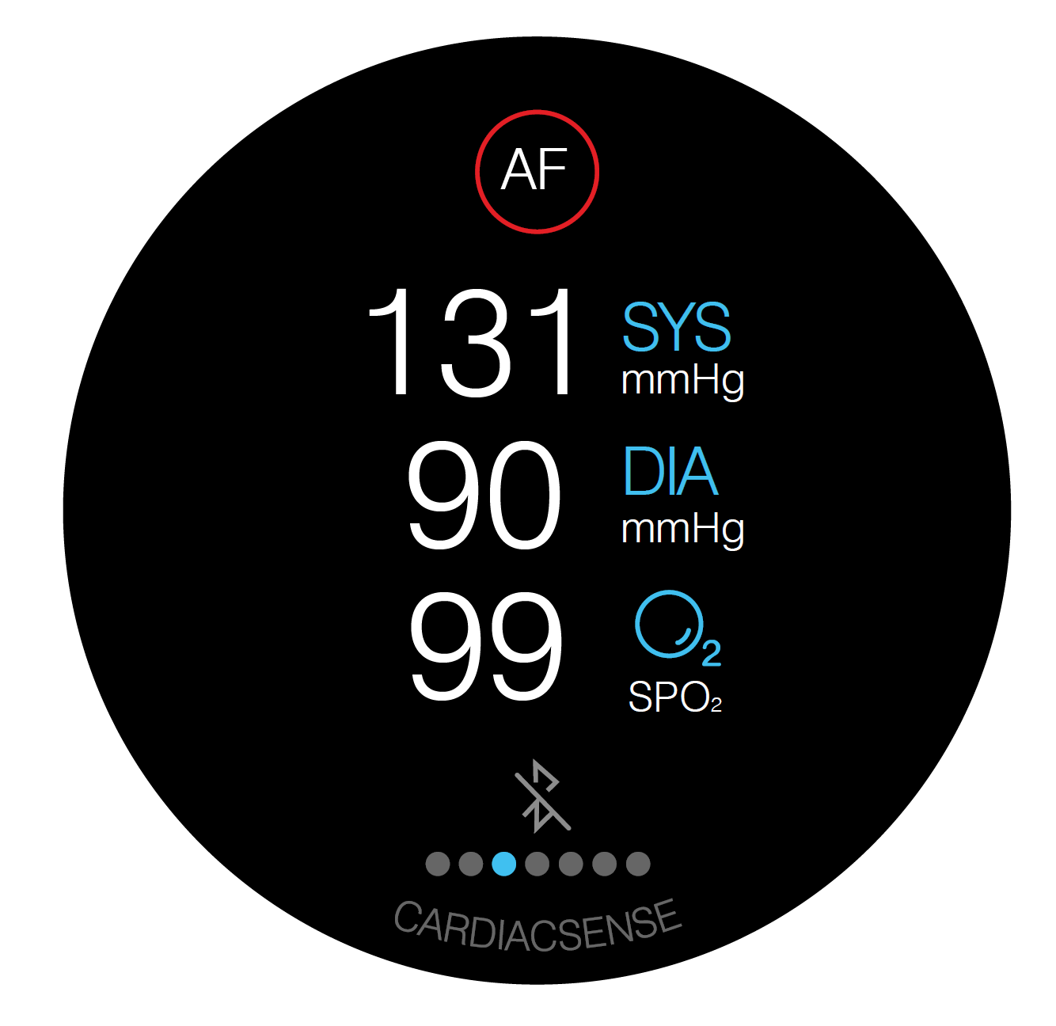
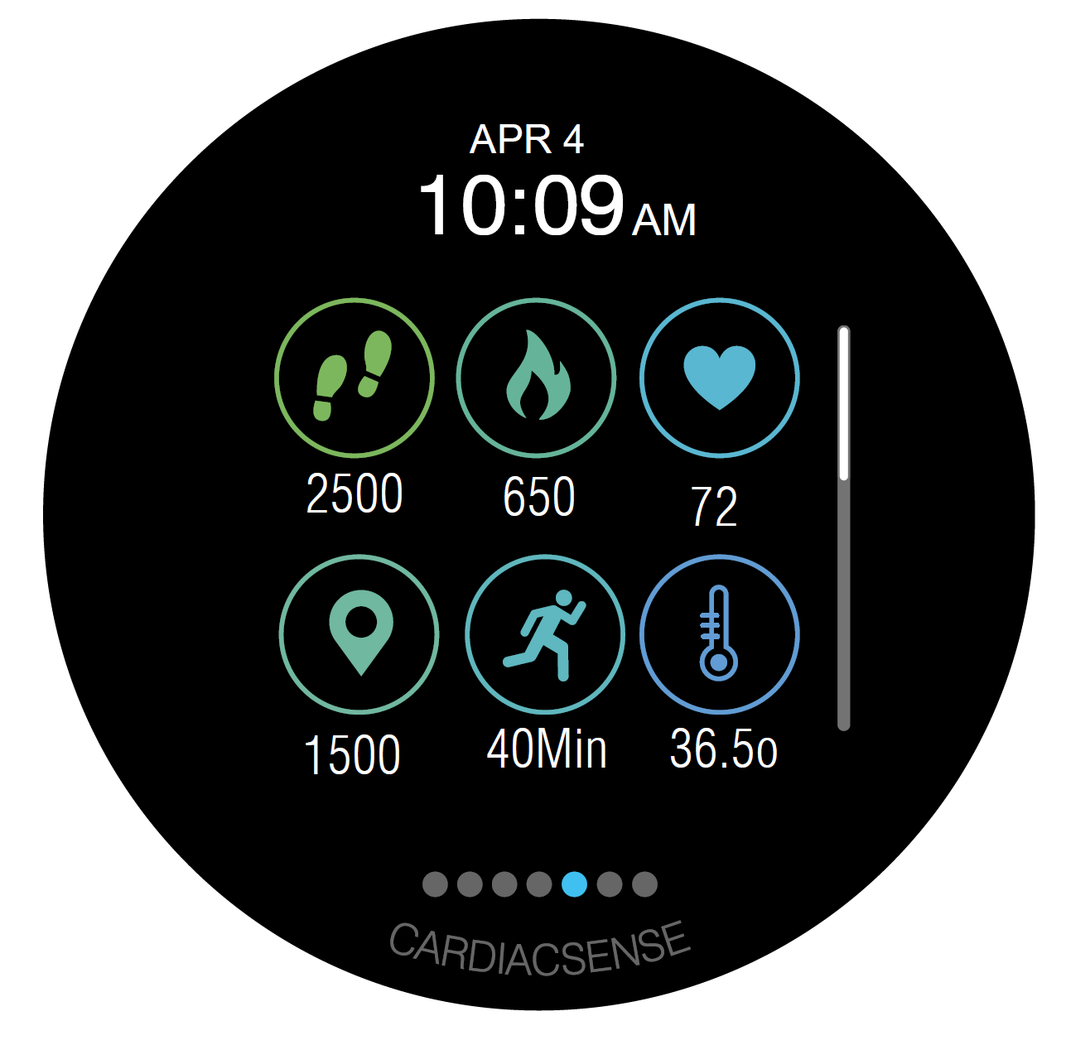



Why are we here?
CONTINUOUS, LONG TERM, AMBULATORY, and NON-INVASIVE monitoring of life-critical functions at MEDICALLY CERTIFIED SENSITIVITY AND SPECIFICITY LEVELS, in order to track:
CARDIOVASCULAR CONDITIONS
VITAL SIGNS
WELL-BEING METRICS
Atrial Fibrillation
Bradycardia
Tachycardia
Cardiac Arrest
COPD
Heart Failure
Sleep Apnea
Long QT Hypertension
Heart Rate (ECG)
Pulse Rate (PPG)
Respiratory Rate
Core Temperature
Oxygen Saturation
Blood Pressure
Activity Tracking
Calories Burned
Galvanic Skin Response
Mental Stress
Sleep Analysis
5

Slide 7
CardiacSense Capabilities
Capability | Medical Watch | Wristband | Clip | Status
Heart Rate / Pulse Rate | ✔️ | ✔️ |  | Submitted to CE & FDA
Arrhythmias (PPG & ECG) | ✔️ | ✔️ |  | AF submitted to CE & FDA. Other arrhythmias will be tested in a single clinical trial in 2021
Electrocardiogram (ECG) | Spot-check / Continuous* | ✔️ |  | Submitted to CE & FDA
Respiratory Rate | ✔️ | ✔️ |  | COPD and CHF – completed clinical trial Respiratory Rate – clinical trial approved. Trial started in November 2020
Core Temperature | Spot-check | Spot-check |  | Laboratory test in May 2021
Oxygen Saturation (SpO2) | Spot-check | Continuous | Continuous | Clinical trial will be conducted by UCSF in January 2021. Submission to CE & FDA in Q1-2021
Blood Pressure | Spot-check | Continuous | Continuous | Clinical trials starting in Q4-2020
Sleep Apnea | ✔️ | ✔️ | ✔️✔️ | Clinical trial will run in Q3-2021
Emergency Button | - | ✔️ |  | No CE & FDA regulation
* In next version
6

Slide 8
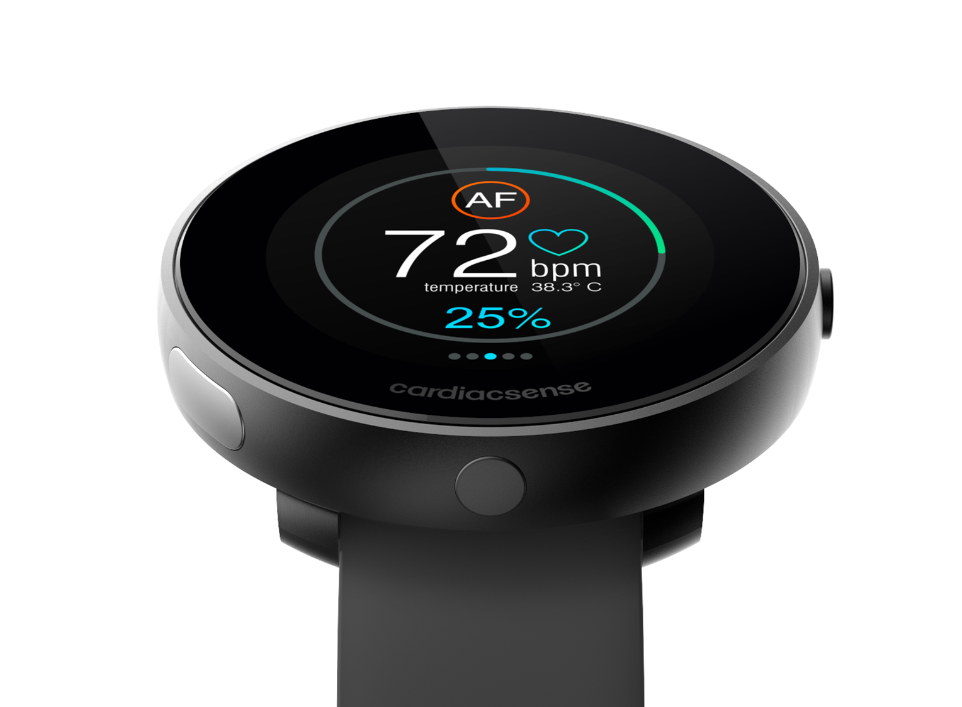

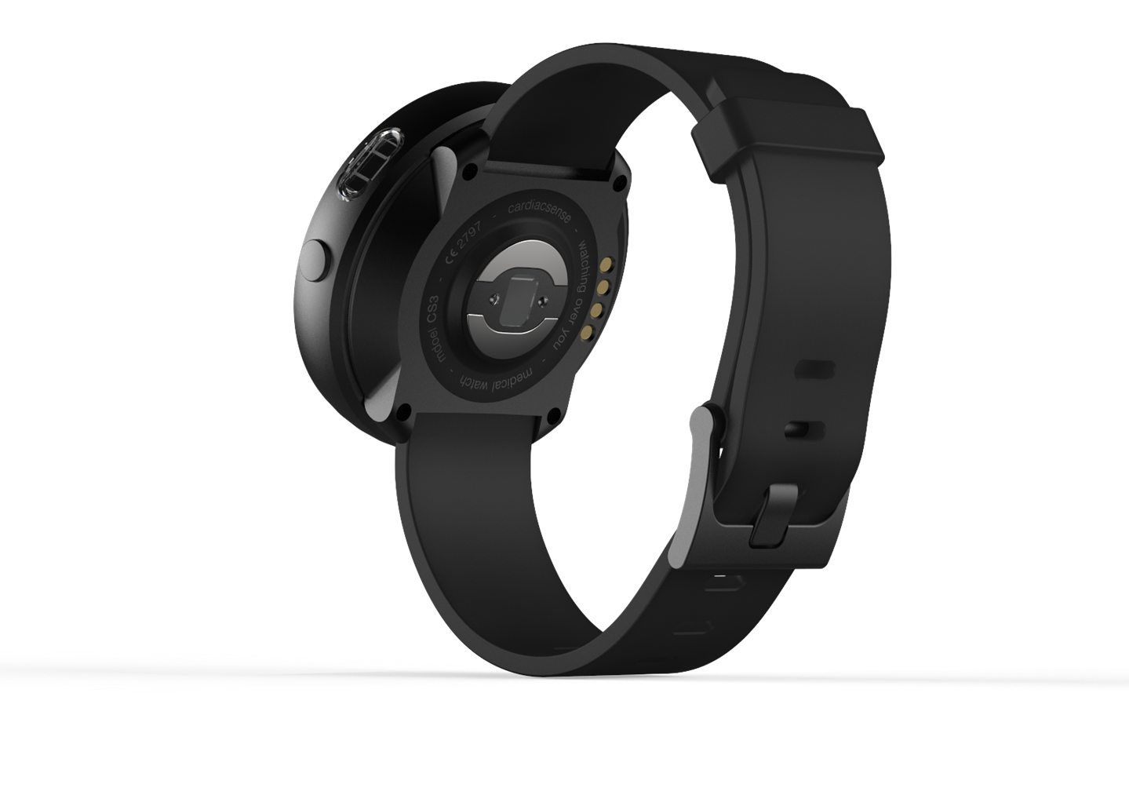
Medical Watch latest design to be launched in Q1, 2021
Side ECG electrode
On/Off button
SpO2 sensor
Bottom ECG electrodes
Respiratory Rate sensor
PPG sensor
Core & Ambient Temperature
7

Slide 9
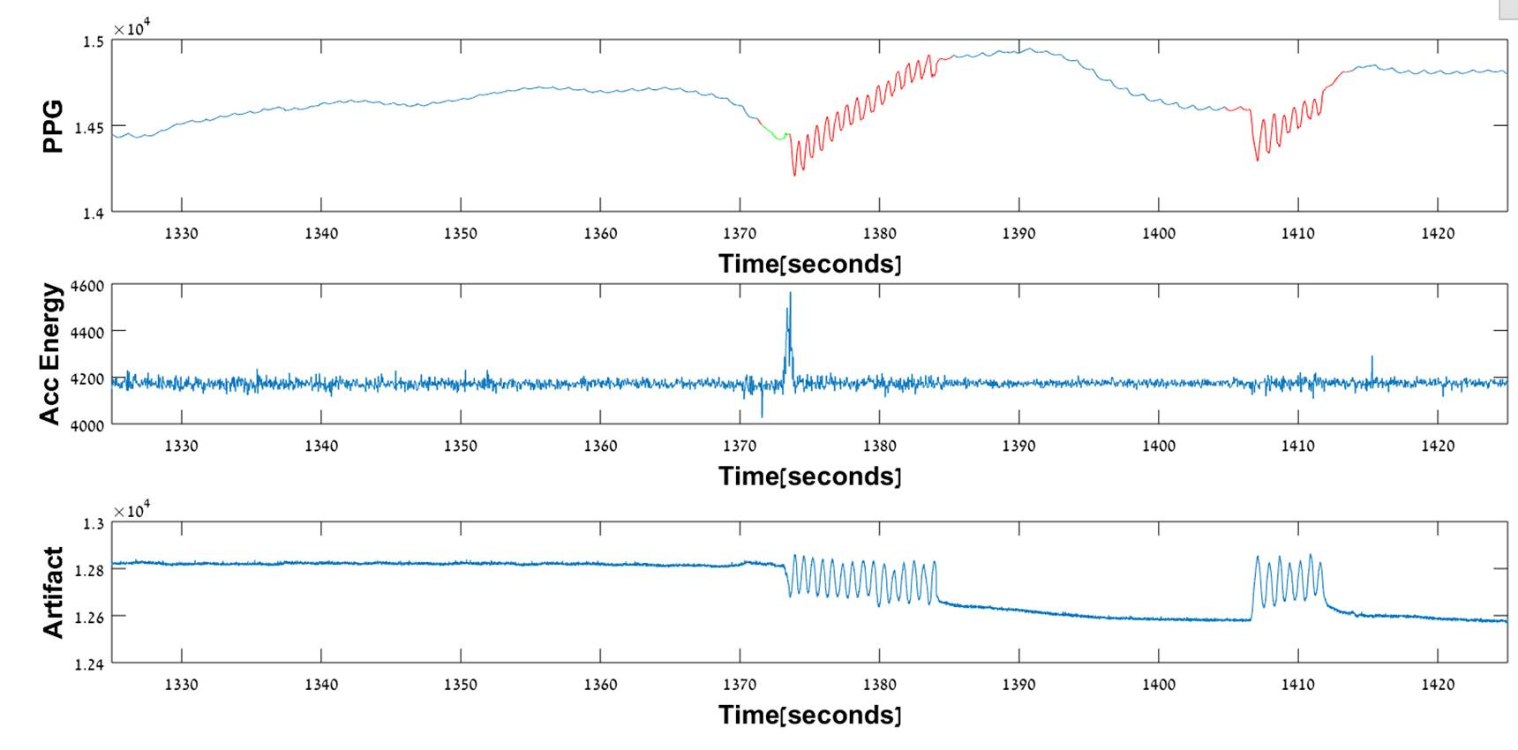
Unique Technological Attributes: Heart Arrhythmia Detection
UPG (Ultra Photoplethysmography) Sensor
Artifacts Sensor
UPG
Unique optics improve signal-to-noise and power consumption
Opto-electro-mechanical sensor cancels artifacts
Fingers movement
Accelerometers do not sense fingers movement
ACCELEROMETERS
Single-charge operating time is 4 days
Artifact sensor detects movements very accurately
ARTIFACT
IP: 2 patents granted,
3 patents pending
IP: 3 patents granted,
2 patents pending
Fingers movement
8

Slide 10
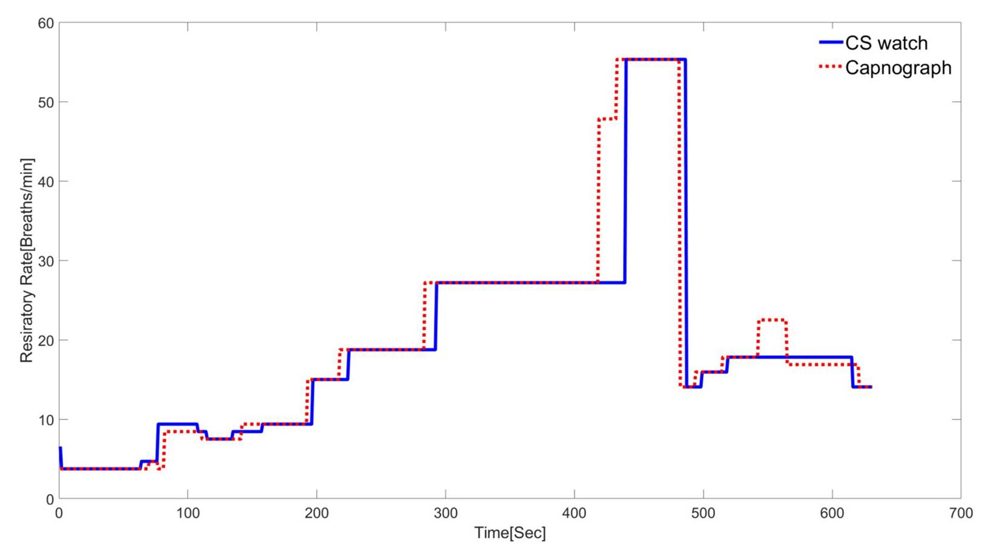
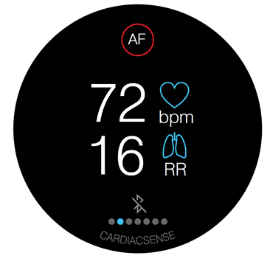
Unique Technological Attributes:
Continuous Respiratory Rate in Ambulatory Conditions
FDA & CE requirements:
Mean error < 3 Breaths / Minute (BrPM)
Max. delay < 45 seconds
Combined opto-mechanical sensor and PPG The only known system for long-term, continuous, ambulatory monitoring of Chronic Obstructive Pulmonary Disease (COPD) and Heart Failure (HF)
The only known system that can measure RR for arrhythmia patients
IP: 2 patents pending
Respiratory Rate range of 4 to 55 BrPM. Mean error = 0
9

Slide 11
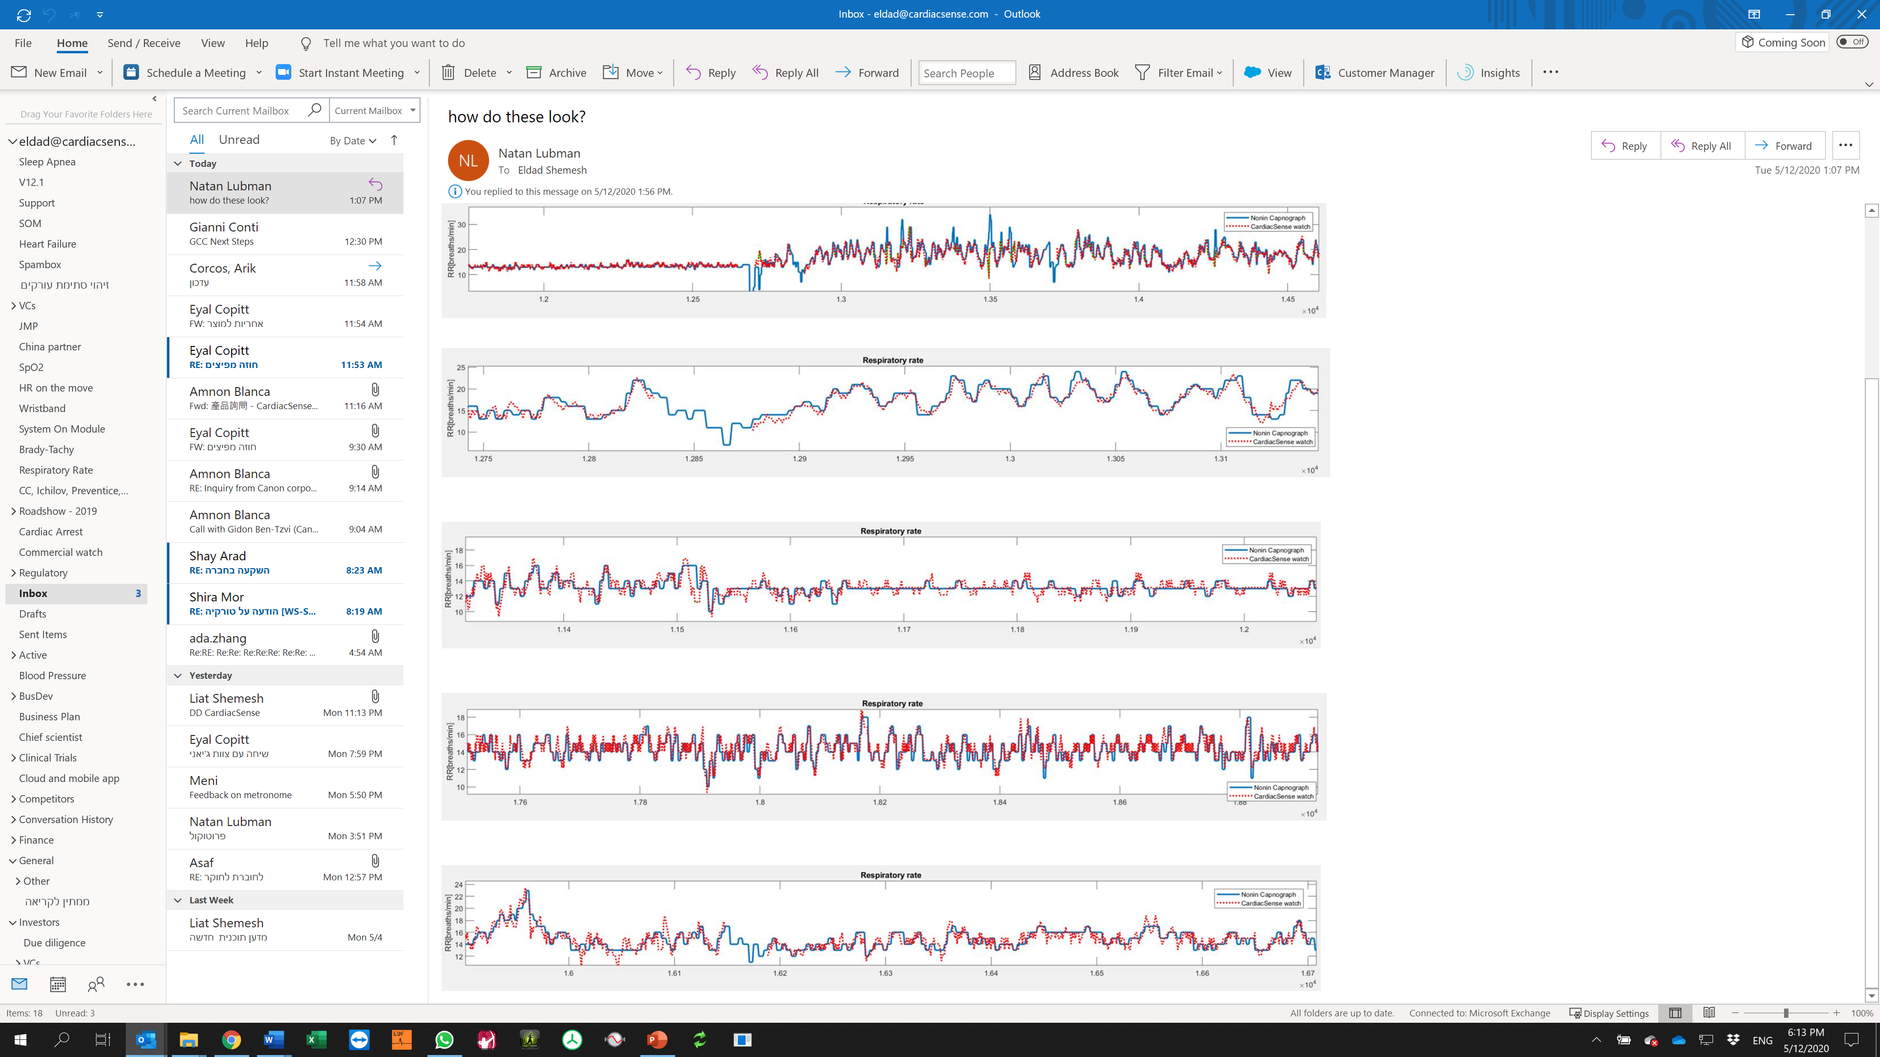
Respiratory Rate
10

Slide 12
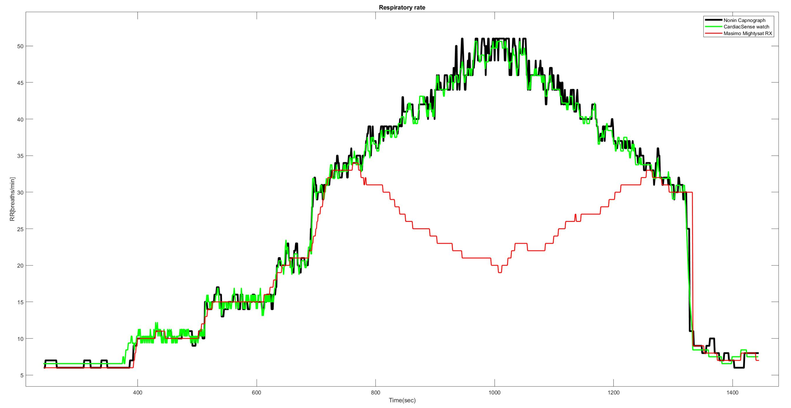
Respiratory Rate: CardiacSense vs. Masimo - Healthy Patient
CardiacSense: Mean error: 0.19 BPM, STD=1.18 BPM
Masimo: Mean error: 7.00 BPM, STD=10.07 BPM
11

Slide 13
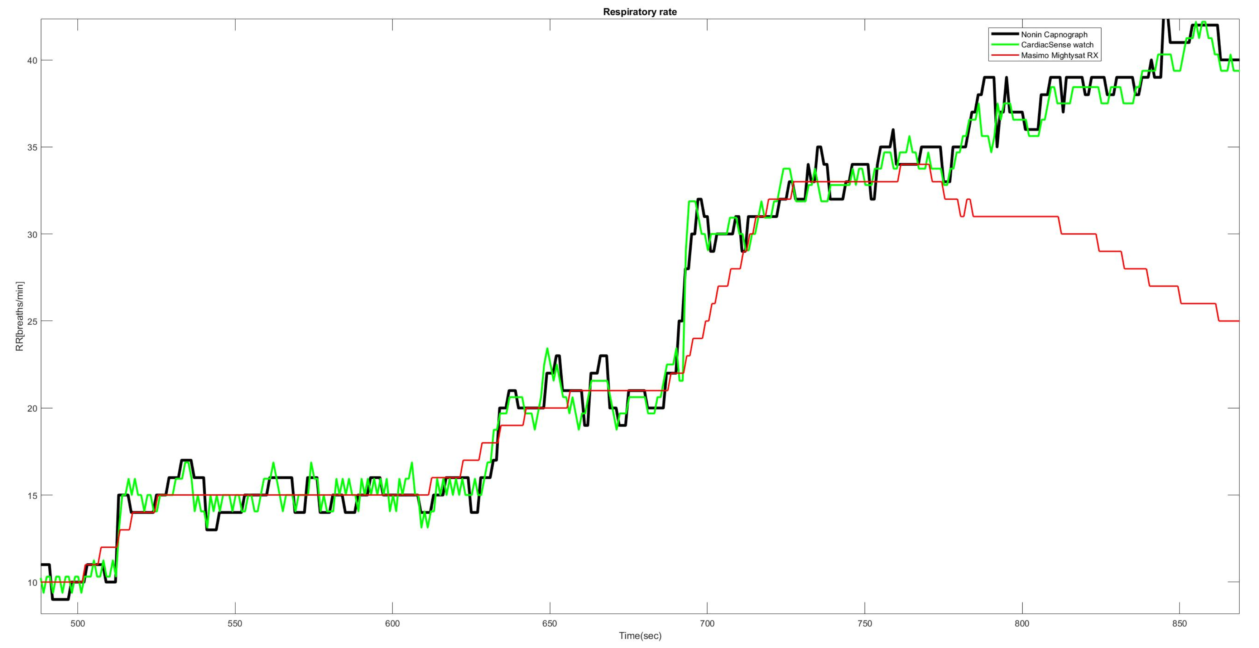
Respiratory Rate: CardiacSense vs. Masimo – Zoom in Early detection of chronic patient's deterioration requires respiratory rate variability Masimo could not measure patients with Atrial Fibrillation
Results without high respiratory rates:
CardiacSense: Mean error: 0.005 BPM, STD=1.09 BPM
Masimo: Mean error: 0.210 BPM, STD=2.05 BPM
12

Slide 14
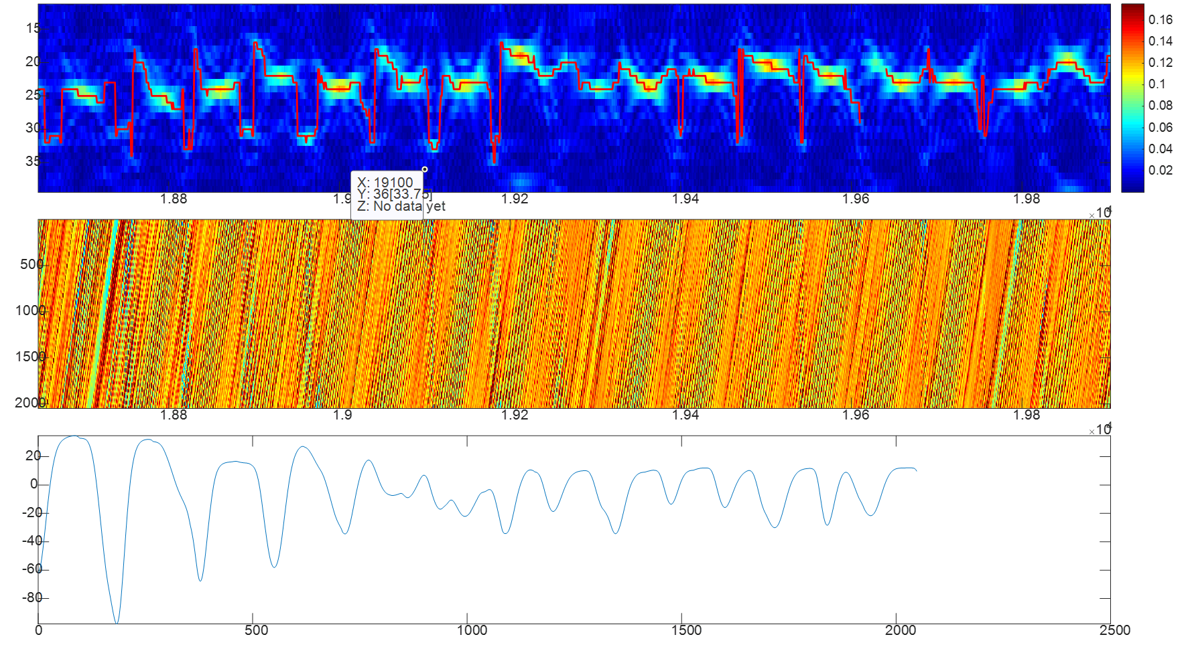
Respiratory Rate of a patient with A-Fib, COPD, CHF & Sleep Apnea Besides CardiacSense, no wrist device can measure respiratory rate for arrhythmia patients
Processed data
Zoom in on sensor raw data shows that we can measure relative depth of breathing and not only breathing rate
Raw data
13

Slide 15
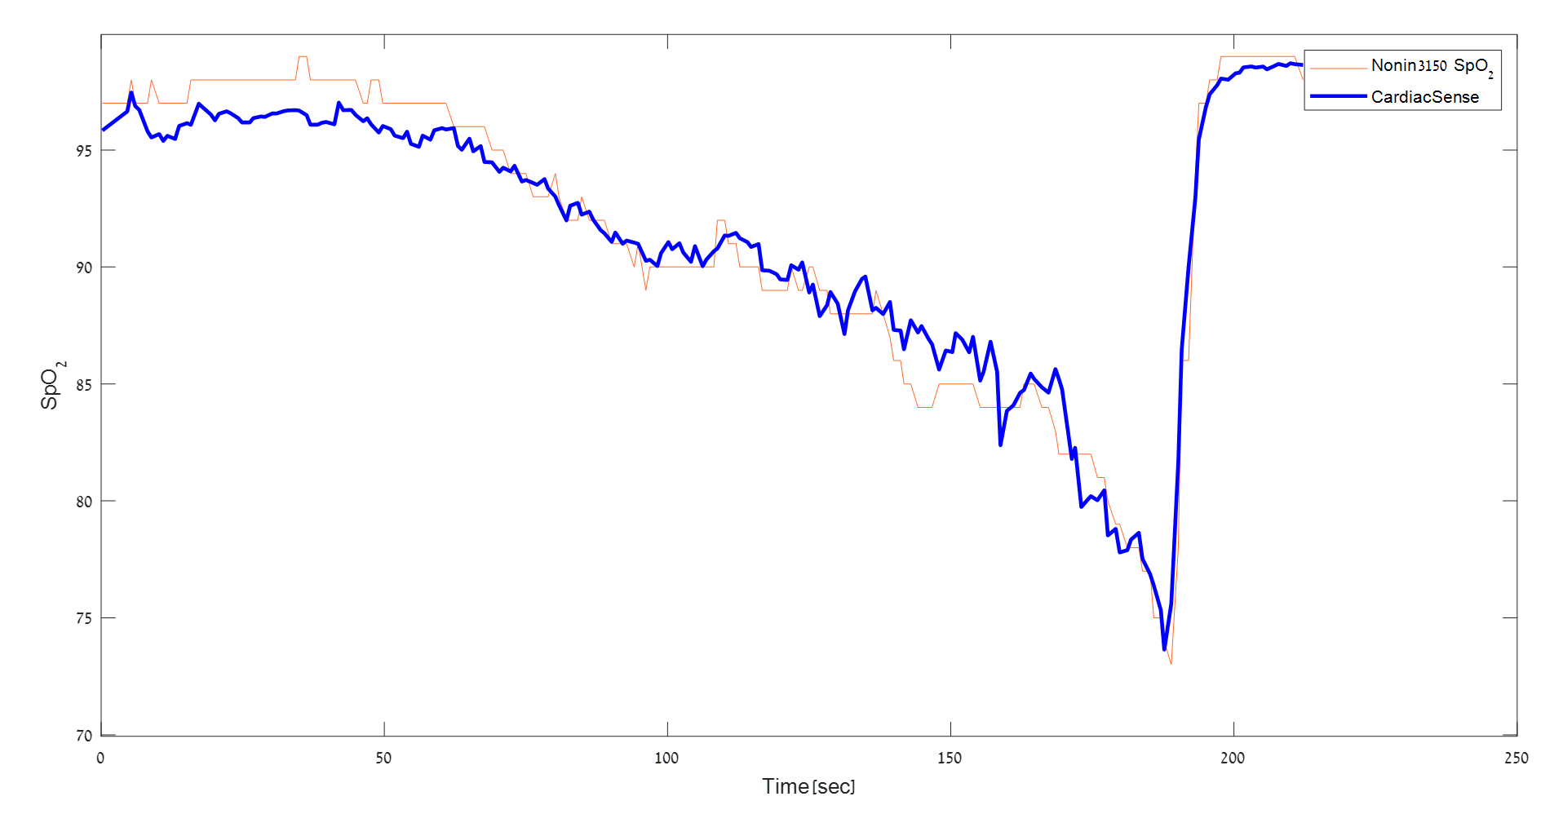
Unique Technological Attributes:
Continuous Oxygen Saturation (SpO2) in Ambulatory Conditions
FDA & CE requirements: Mean error < 3%
Unique multi-wavelength optical sensor
IP: 3 patents pending
Oxygen saturation in range of 70-100% Mean error = 1.3%
14

Slide 16
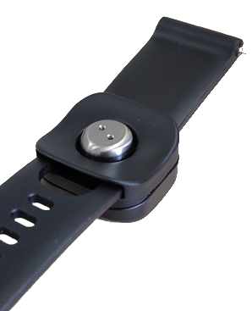
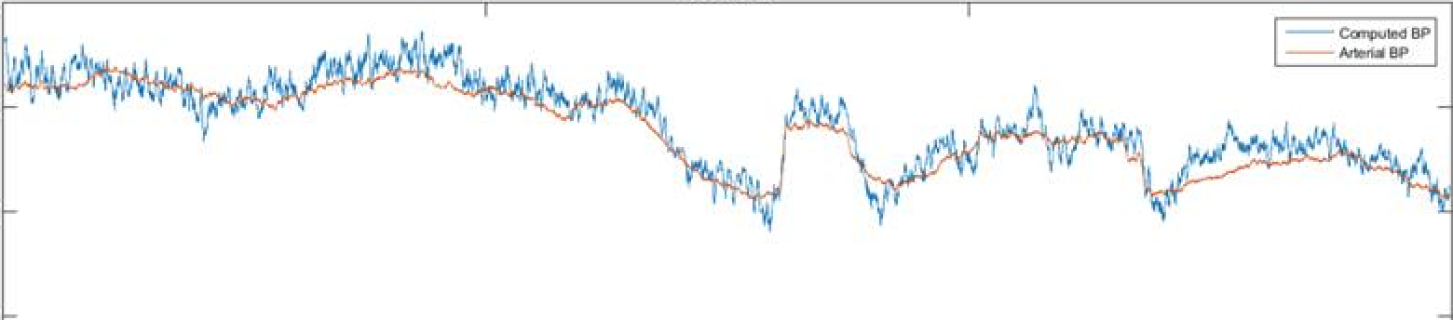
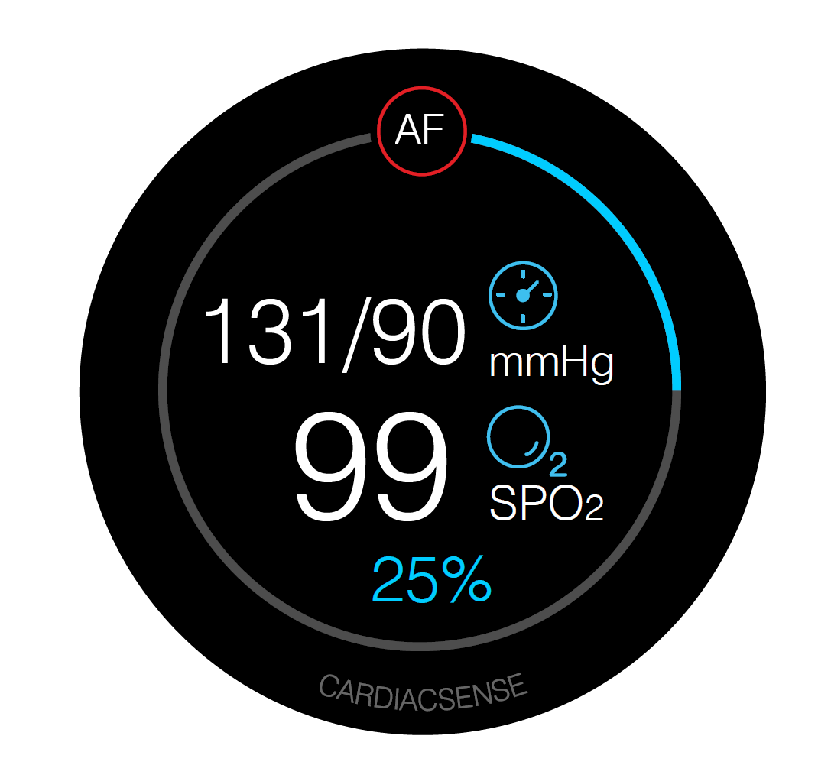
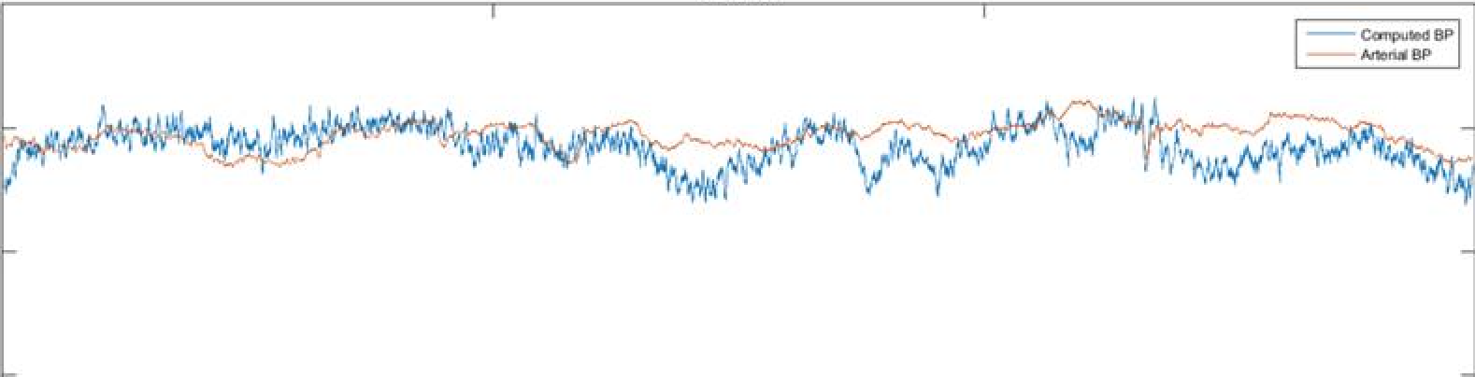
Unique Technological Attributes: Blood Pressure Measurement
FDA & CE requirements: Mean error < 5 mmHg Std. dev. < 8 mmHg
Non-inflating Opto-electro-mechanical sensor over the radial artery
Results of tests at hospital Intensive Care Units (ICU) meet FDA & CE requirements
Focus is on making the sensor more positioning agnostic
We expect major progress in Q1, 2021
mmHg = millimeters of Mercury
SYSTOLIC
140
120
100
80
mmHg
9,000 measurements | Mean error = 1.49 Std. dev. = 2.75
0 Minutes 150
DIASTOLIC
60
50
40
30
mmHg
9,000 measurements | Mean error = 0.88 Std. dev. = 1.61
0 Minutes 150
IP: 2 patents pending
15

Slide 17
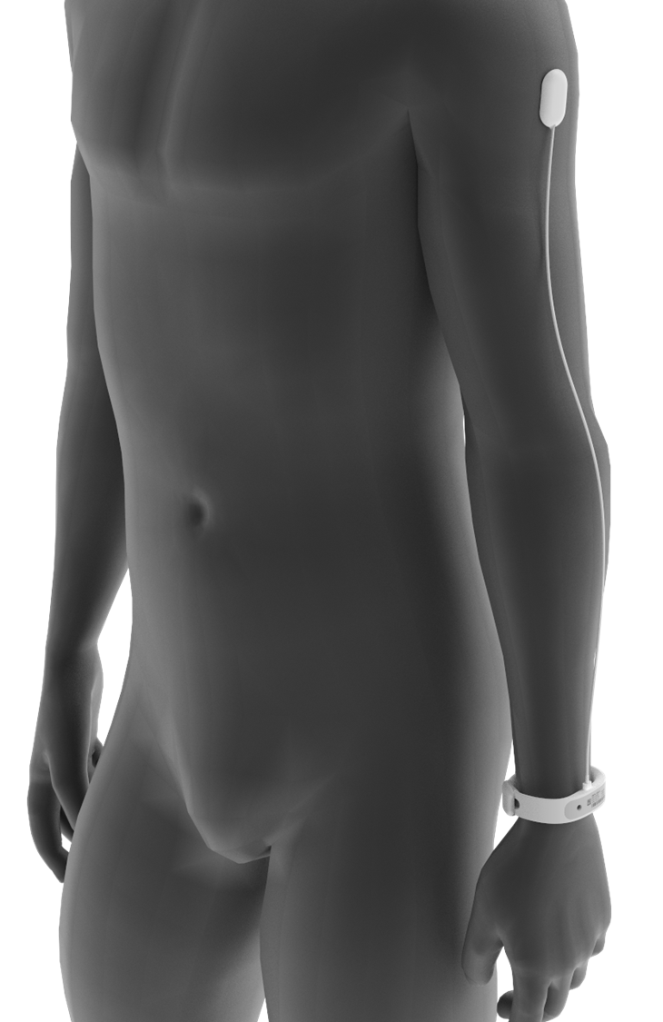
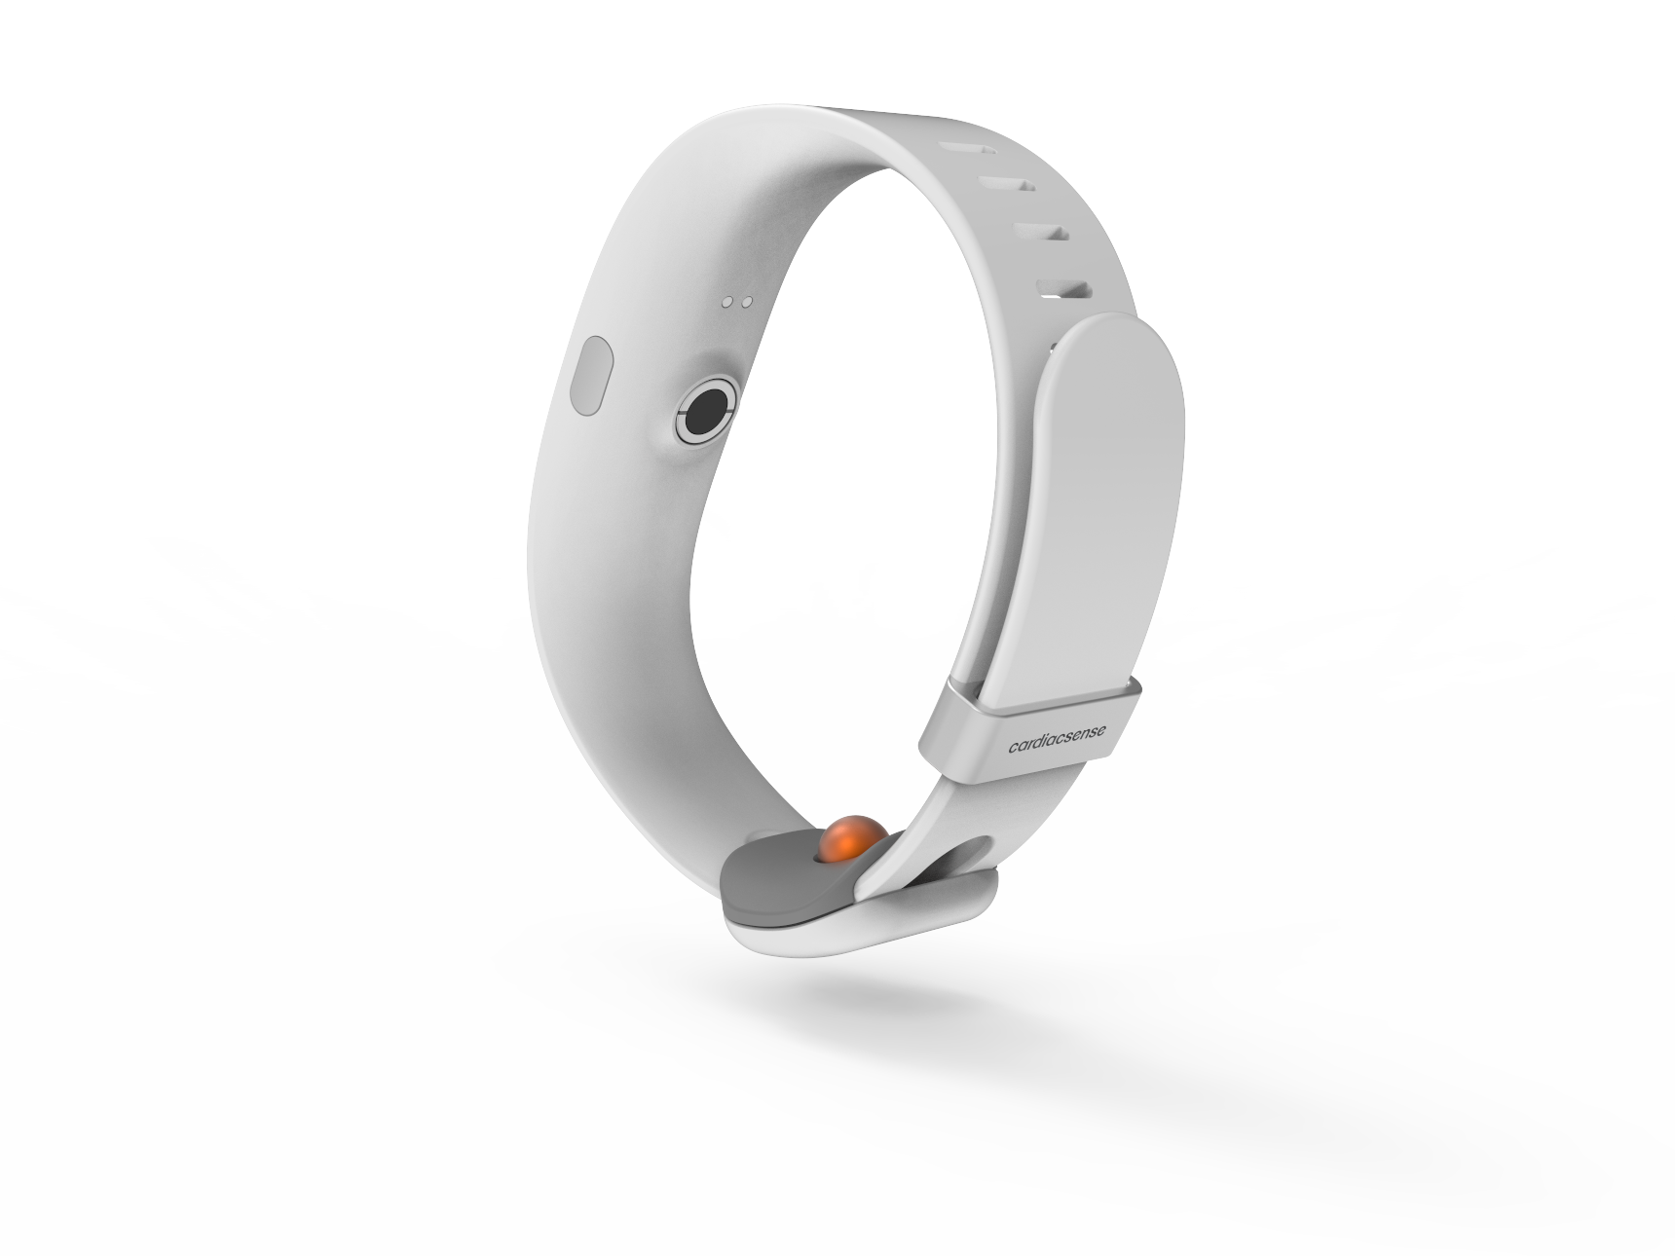
For hospitals, the product hardware consists of a medical wristband with extended capabilities (Temperature, SpO2 and continuous ECG)
Electrode for spot-check ECG
UPG & ECG electrodes, and respiratory sensor
Flexible display for patient identification
Blood Pressure and SpO2 sensors
Connector for continuous ECG
Core Temperature sensor
16

Slide 18


Coronavirus symptoms include high Core Temperature, high Heart Rate, high Respiratory Rate and low Oxygen Saturation (SpO2) – all of which can be monitored by the CardiacSense wristband
Flexible display for patient identification and messages from nurses
UPG sensor for Heart Rate and RR sensor for Respiratory Rate
Blood Pressure and SpO2 sensors
Connector for continuous ECG / Heart Rate
Two-directional communication to
Nurses’ Station
Core Temperature sensor
17

Slide 19
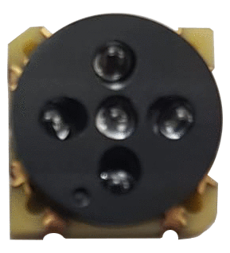
The core technology will be miniaturized into an FDA, CE & NMPA-cleared System-on-Module (SOM)
Electronics
Optics
Algorithms
Each device using the SOM (e.g. wristband, wristwatch, finger ring etc.) will be FDA, CE & NMPA -cleared without requiring further clinical trials
0
1
0
cm
1
System-on-Module (SOM)
18

Slide 20
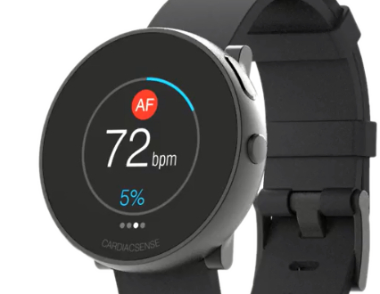
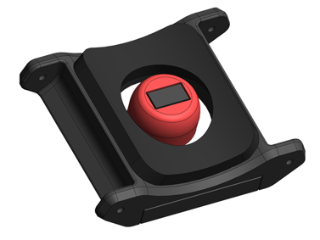
Roadmap
Blood pressure – continuous Stroke Volume Galvanic Skin Response Fall early warning and detection
Cardiac Arrest
Respiratory Rate
Core Temperature – spot check
SpO2 – spot check
Blood Pressure – spot check
Pause, Brady, Tachy, QT
Physical Activity
Present (Submitted to CE) Atrial Fibrillation
Heart Rate
Pulse Rate
ECG – spot check
SpO2 over the wrist Sleep Apnea
H2, 2020
Medical watch
2021
H1, 2022
H2, 2022
Medical watch
Medical watch
System-On-Module
Medical watch
System-On-Module Wristband
19

Slide 21
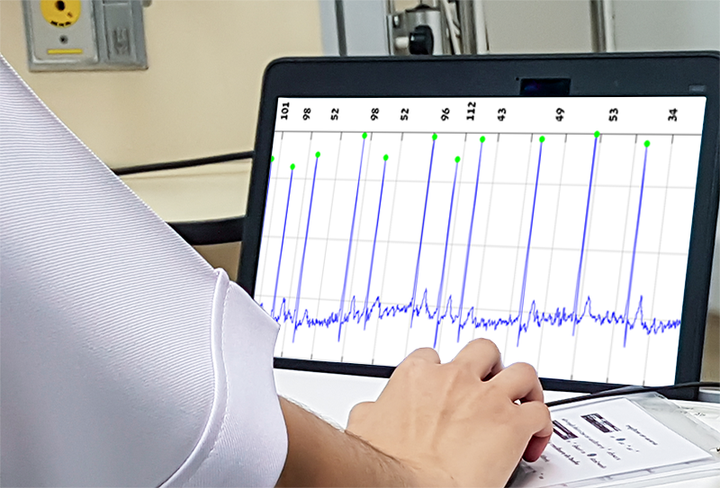
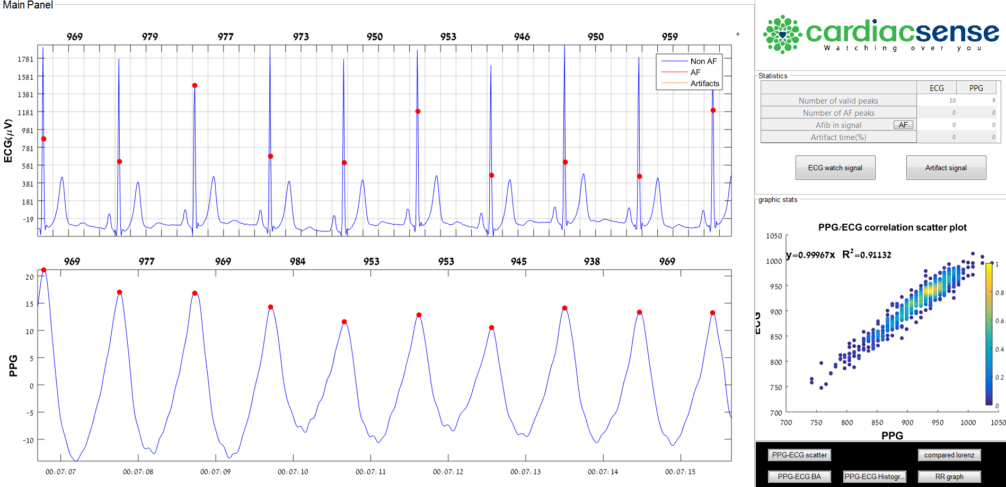
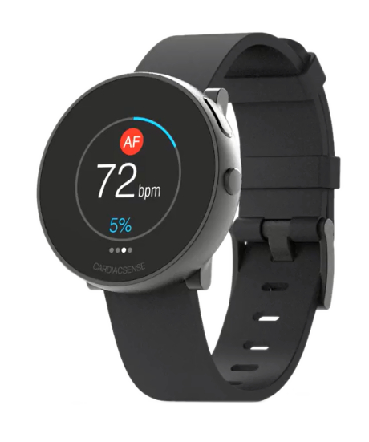
FDA, CE & NMPA protocol for AF detection clearance
1st (Preliminary) Clinical Trial - Q1 2019
Sourasky Medical Center
2nd (Pivotal) Clinical Trial – Q4 2019
Sourasky Medical Center, Rambam Medical Center, Sheba Medical Center
ECG
99% Sensitivity & Specificity
99% Sensitivity & Specificity
PPG
FDA, CE & NMPA threshold:
FDA, CE & NMPA threshold:
over 96% beat-to-beat sensitivity between ECG and PPG across 24 patients
over 95% consistency between medical watch and cardiologist diagnostic of AF detection across 30 patients
20
20

Slide 22
1st Clinical Trial results for AF detection by PPG for FDA, CE & NMPA Clearance
Sensitivity
FDR False Detection Rate
Correlation coefficient
Regression line slope
PPV Positive Predictive Value
Bland-Altman 95% limits of agreement
99.1%
0.6%
97.8%
1.00
99.4%
27.5ms
Average
Average
Average
Average
Average
Average
96%
or higher
2%
or lower
90%
or higher
1± 0.02
80%
or higher
Average (±tolerance) ± 1.96*SD: 0 (±5) ± 100
FDA, CE & NMPA Threshold
Clinical CardiacSense Results
21

Slide 23
2nd Pivotal Trial results for AF detection by PPG and/or ECG for FDA, CE & NMPA Clearance
PPG
ECG
Type
Sensitivity
Specificity
Sensitivity
Specificity
98.9%
99.9%
95.4%
100.0%
Average
Average
Average
Average
95%
or higher
95%
or higher
95%
or higher
95%
or higher
Paroxysmal AF (no episodes)
Healthy
Healthy
Persistent AF (with Cardioversion)
Paroxysmal AF (no episodes)
Healthy
Paroxysmal AF (no episodes)
Healthy
Healthy
Healthy
Persistent AF (with Cardioversion)
Permanent AF
Permanent AF
Permanent AF
Paroxysmal AF (no episodes)
Paroxysmal AF (no episodes)
Permanent AF
Permanent AF
Healthy
Permanent AF
Paroxysmal AF (no episodes)
Permanent AF
Paroxysmal AF (no episodes)
Healthy
Healthy
Paroxysmal AF (no episodes)
Healthy
Healthy
Healthy
Healthy
N/A
N/A
N/A
N/A
N/A
N/A
N/A
N/A
N/A
N/A
N/A
N/A
N/A
N/A
N/A
N/A
N/A
N/A
N/A
N/A
N/A
N/A
N/A
N/A
N/A
N/A
N/A
N/A
N/A
N/A
N/A
N/A
N/A
N/A
N/A
N/A
N/A
N/A
N/A
N/A
N/A
N/A
N/A
N/A
N/A
N/A
N/A
N/A
N/A
N/A N/A
N/A
N/A
N/A
N/A
N/A
FDA, CE & NMPA Threshold
Clinical CardiacSense Results
22

Slide 24
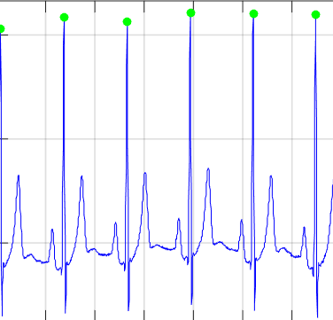
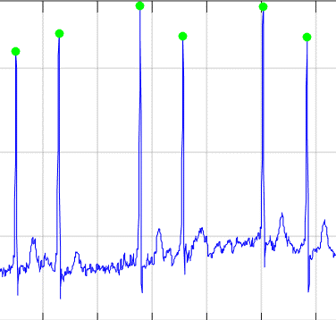


Regular pulse
Atrial Fibrillation
Market Opportunity
Atrial Fibrillation (AF) Detection
24 / 7 / 365
12
10
X5
$B
€B
AF increases the risk of stroke by 5x and stroke severity by 5x
The cost of AF-related strokes (in the U.S.)
The cost of AF-related strokes (in Europe)
Long term monitoring is the only known effective solution for heart arrhythmias
Source for$12B: Natale, A. &, Jalife, J (Eds). (2008) Atrial Fibrillation: From Bench to, (p. 13), NJ: Humana Press Source for Euro 10B: https://www.stopafib.org/downloads/News436-Europe-Prevent.pdf
23

Slide 25
Addressable Market Size
Atrial Fibrillation (AF) Detection
U.S. Arrhythmia opportunity (Annual patients in millions)
General Population Consumer wearables
DETECTION
High Risk Asymptomatic Risk factors: stroke, age, hypertension, heart failure, diabetes, etc.
10+ M
DIAGNOSIS
5M
Symptomatic Initial Diagnostics
1M
MANAGEMENT
Post-AF Procedures Ongoing Management
24

Slide 26
Competition – Atrial Fibrillation (AF) Detection
Parameter | CardiacSense | Leading Consumer Benchmark¹ | CardiacSense Advantage
Application/Label | AF Detection | Irregular Rhythm Suggestive of AF | Specific label for AF detection; strong marketing benefit relative to competition
Quickest Time to Detection of AF | ~5 minutes | Requires at least 10 hours | CardiacSense technology, which correlates beat by beat, can detect AF much more rapidly
Sensitivity (beat by beat detection) | 99% (FDA threshold is ≥96%) | N/A | Substantially better sensitivity than competing benchmark devices on a beat by beat basis
False Detection Rate (beat-by-beat) | 0.6% (FDA threshold is ≤2%) | N/A | CardiacSense proprietary artifact sensor helps avoid false positives
Operation Mode | Continuous | Intermittent (once every 2 hours) | CardiacSense medical watch performs continuous monitoring and has 4-day battery life
Specificity for AF Detection | 99% (FDA threshold is ≥95%) | 71% | CardiacSense has demonstrated avoidance of false positives, key to consumer success
Sensitivity for AF Detection | 99% (FDA threshold is ≥95%) | 79% | CardiacSense has well surpassed FDA threshold levels and is best-in-class
More recent studies by Mayo Clinic indicates Specificity of 15% for Leading Consumer Benchmark
https://www.theverge.com/2020/10/1/21496813/apple-watch-heart-monitor-ekg-false-positive
25

Slide 27


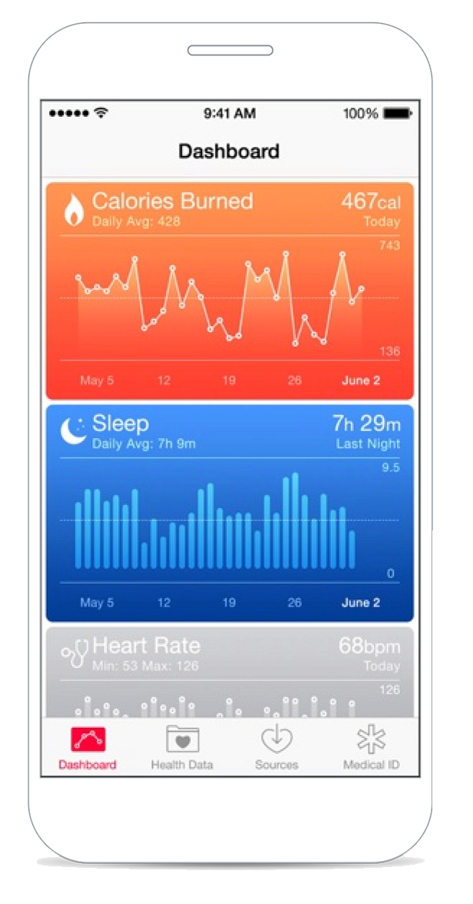
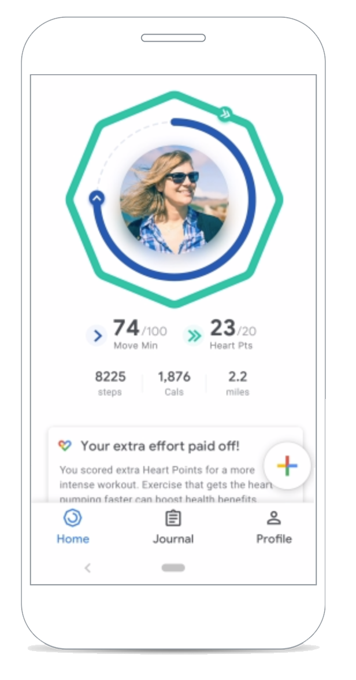





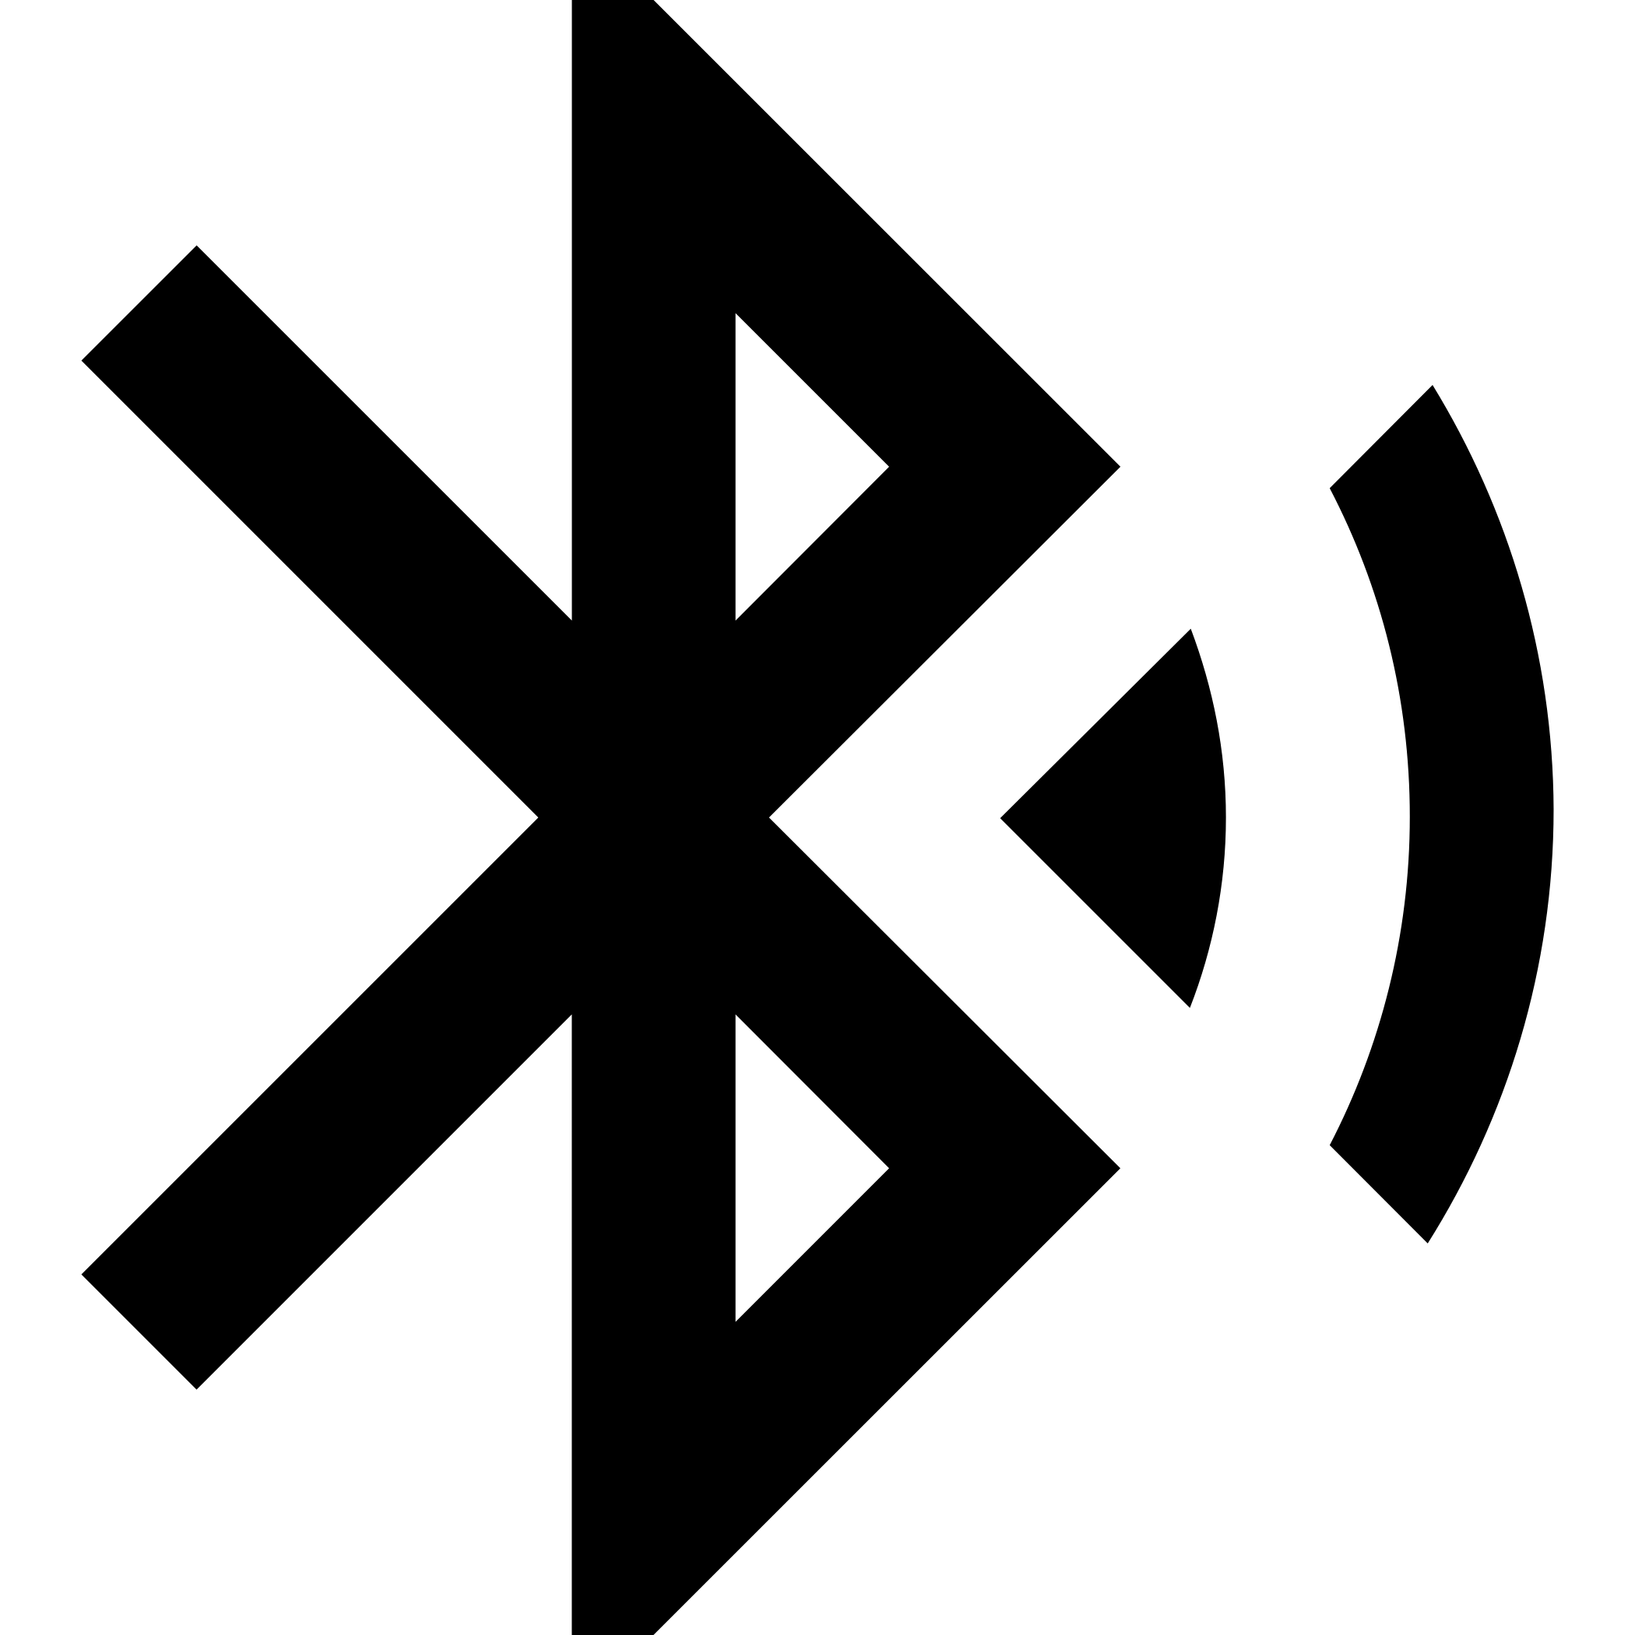
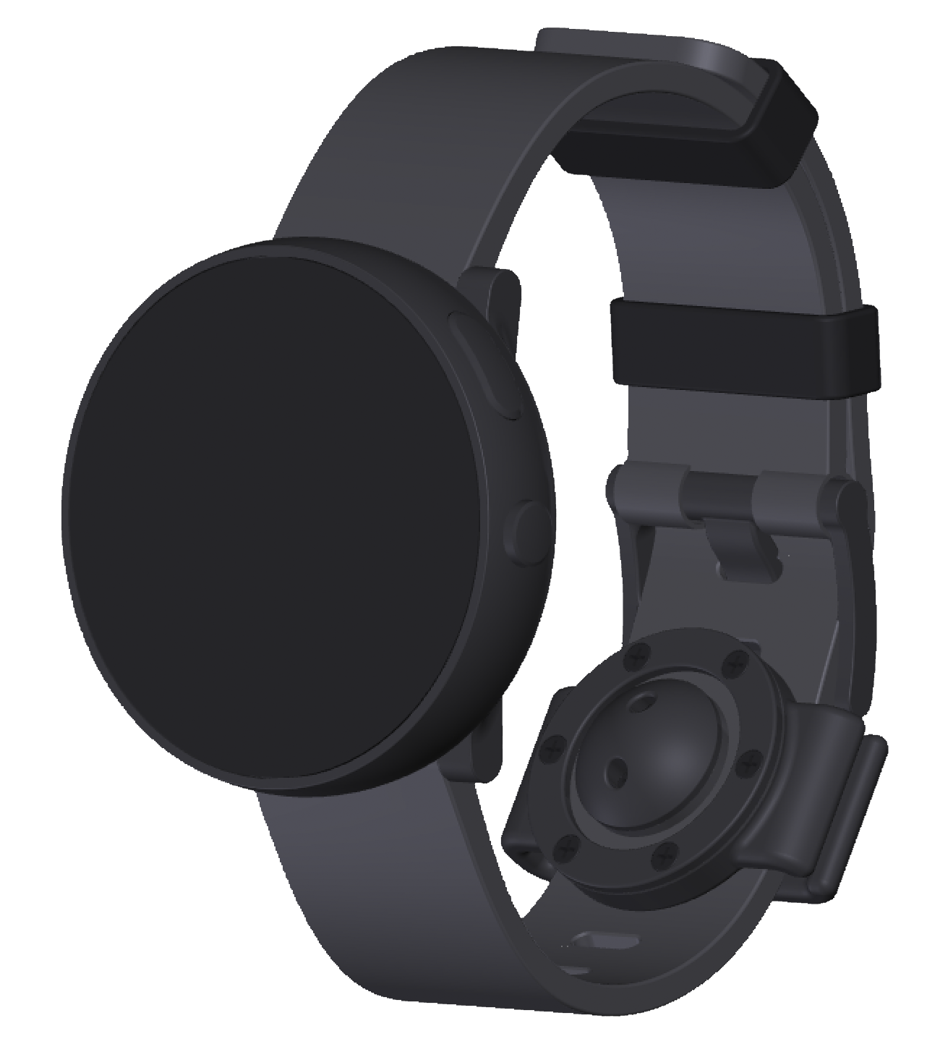


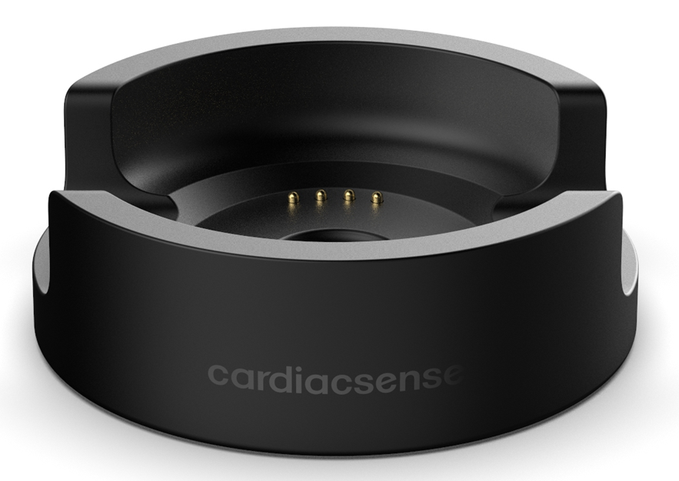




CardiacSense Medical Watch Connectivity Ecosystem
Patient reports
Instantaneous real-time data in case of event detection, and continuous processed data
Offline data
Hospital Electronic Medical Records Cloud
Real-time data
HIPPA/GDPR Compliant
Patient Big Data & AI Analytics for early detection of critical events through digital health applications such as Google Fit and Apple HealthKit
Offline / online data
Big Data & AI Analytics Cloud
CardiacSense Cloud
Offline data
Offline (all raw data)
Offline (Full Disclosure) and real-time (event) data
CardiacSense
Medical Watch Cradle
Monitoring Center Cloud

Slide 28
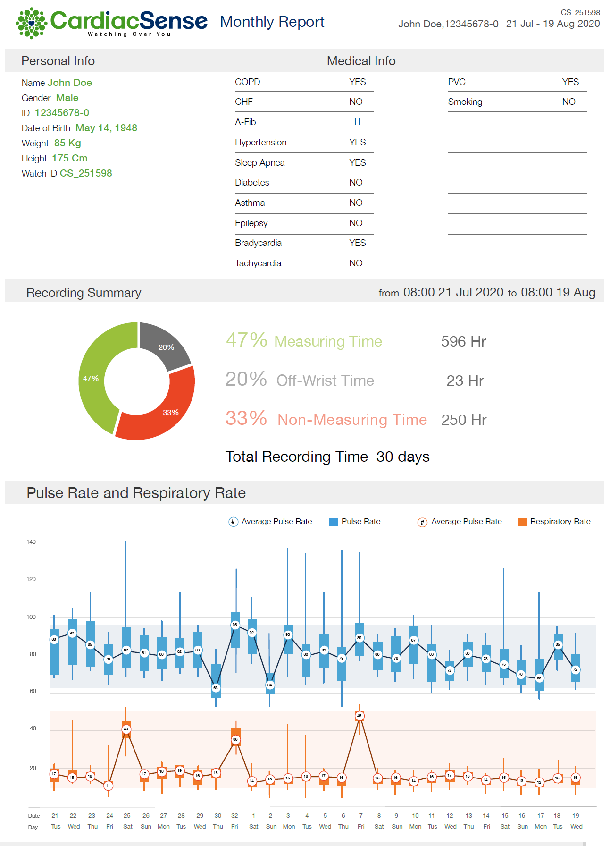
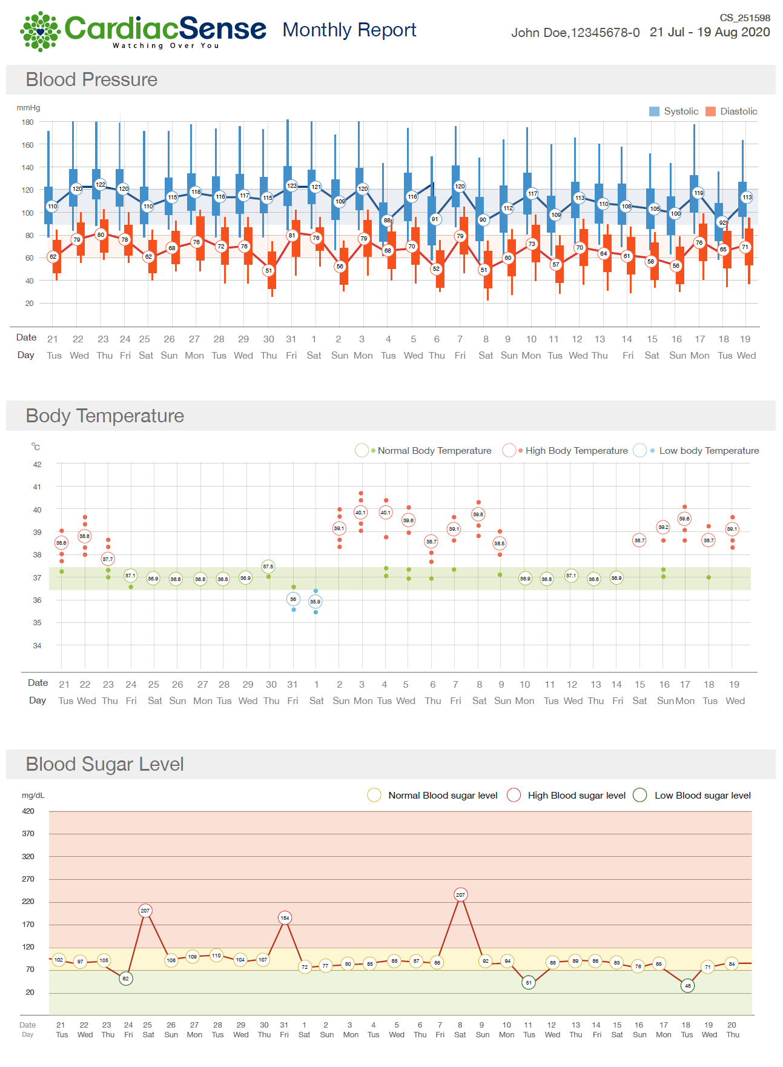

Slide 29

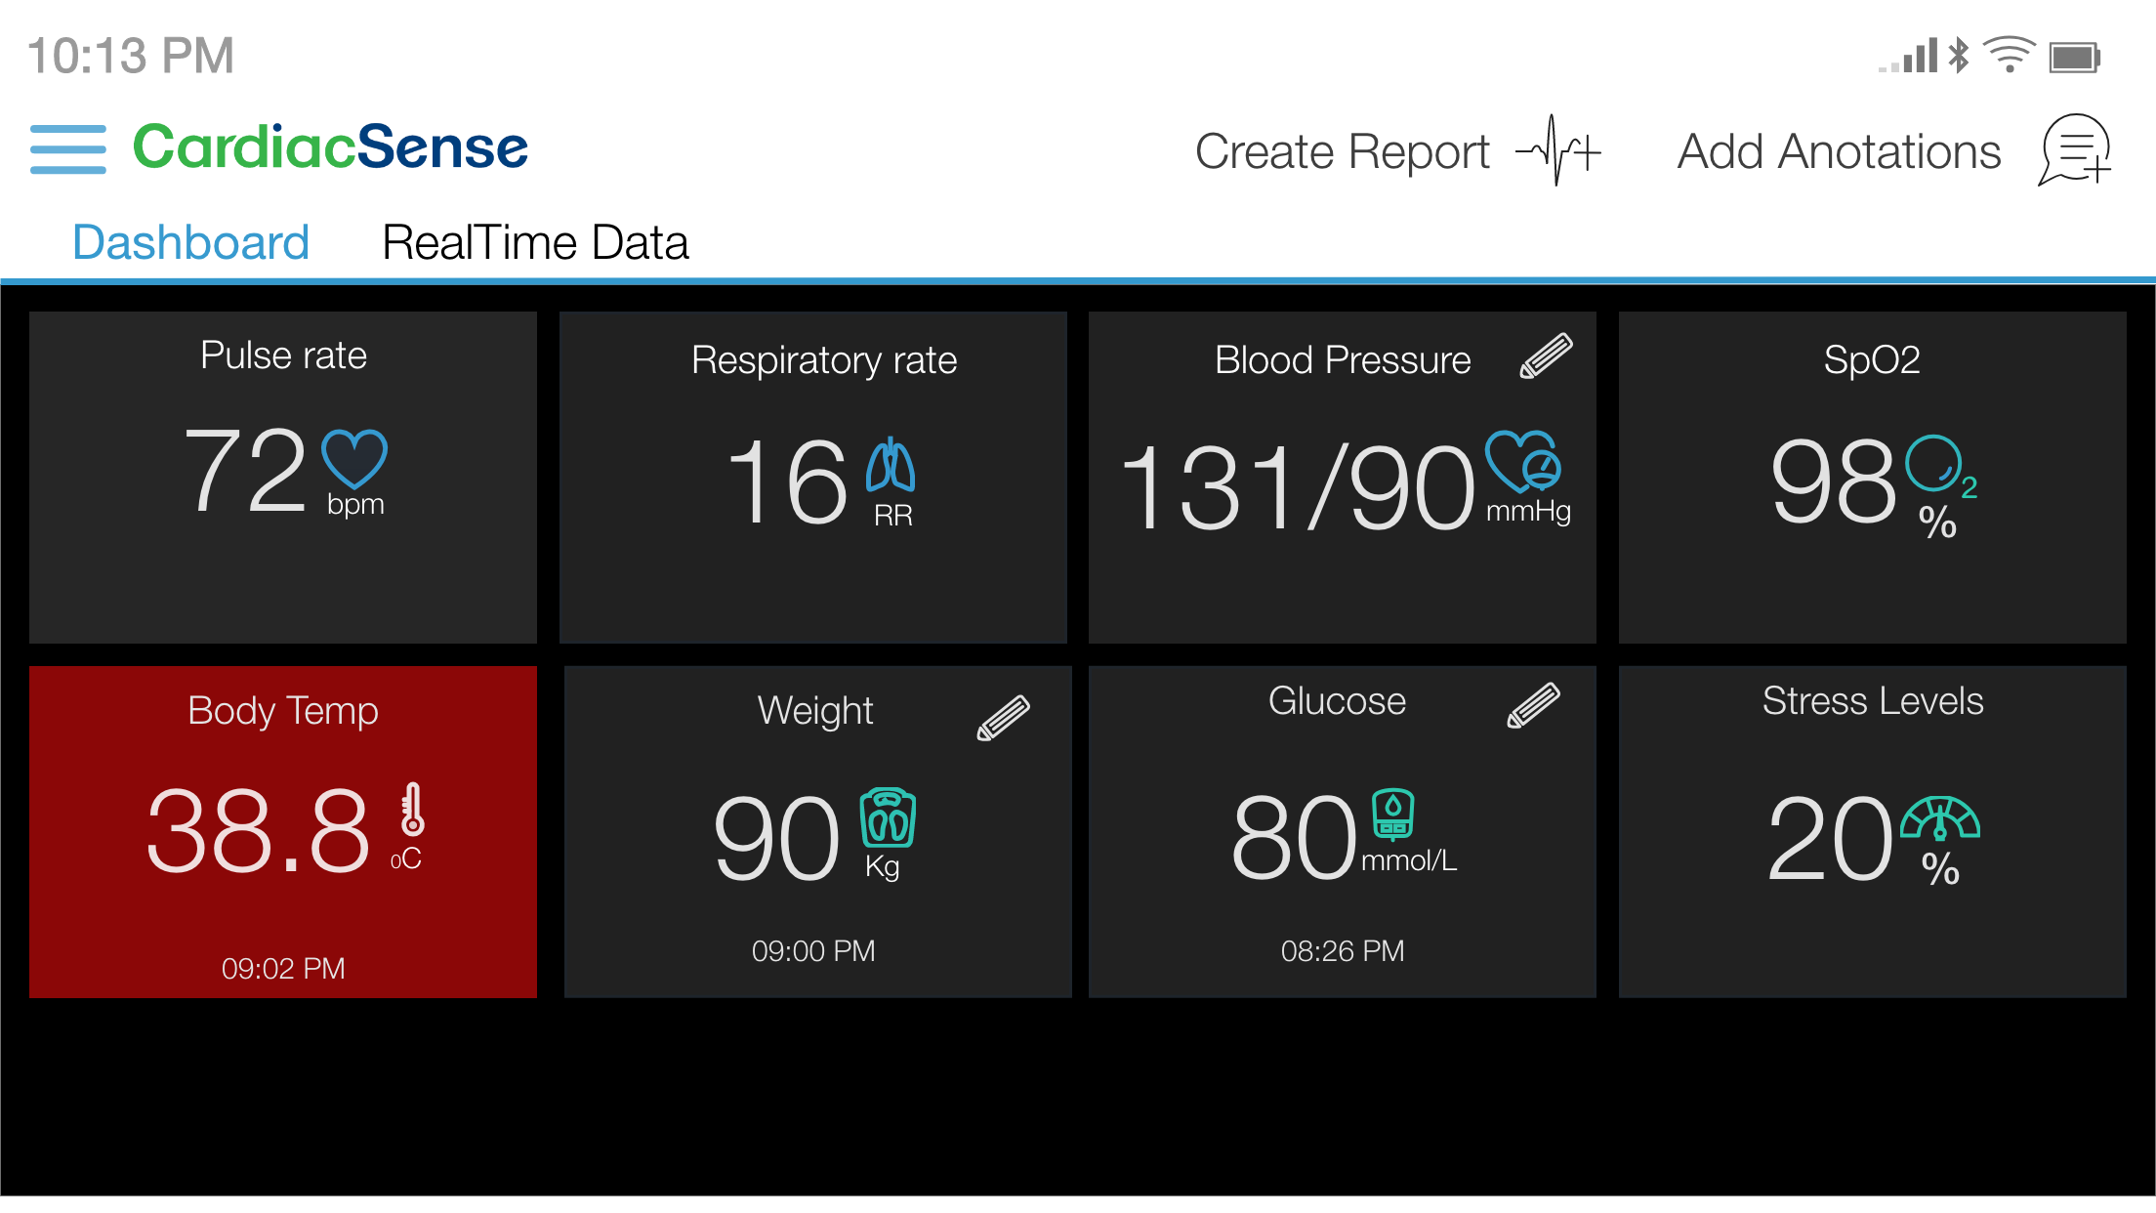
MAIN SCREEN – DASHBOARD

Slide 30
Indication | Primary Endpoint | Hospitals | Trial Description | Date Planned
Atrial Fibrillation | Bleeding and ischemic stroke reduction via Pill-In-The-Pocket concept | Oxford University Hospital | 5,000 paroxysmal subjects: 2,500 will wear the CS watch and will use pill-in-the-pocket concept; 2,500 will take medications as instructed (part will not take anticoagulants and part will) | 2021-2022 (18 months)
 | AF detection for post-ablation patients | UCSF (University of California San Francisco) Professor Jeffrey Olgin | 200 subjects will wear the CS watch and will go for additional ablation when AF burden will cross a threshold | 2020-2023 (24 months)
 | Reduction of ischemic stroke and bleeding occurrence for high risk for AF stroke patients (CAHDS-VAS) | Maccabi Healthcare Services HMO (Israel) Prof. Varda Shalev | 1,000 subjects will wear the CS watch and will be given anticoagulants based on AF burden. 1,000 patients will take medication based on Holter tests | 2020-2021 (12 months)
Clinical Trials related to Heart Arrhythmias
(not for regulatory purposes)
CardiacSense Medical Watch as a Big Data Collection Platform
29

Slide 31
Indication | Primary Endpoint | Hospitals | Trial Description | Date Planned
Respiratory Rate (RR) and Chronic Case Monitoring (CCM) | Respiratory Rate monitoring To be submitted to FDA & CE for continuous RR indication | Tel Aviv Sourasky Medical Center, Ichilov Hospital– Internal Medicine F Prof. Giris Jacob | 40 healthy subjects will wear the CS watch and capnograph. Protocol will include breathings from very low to very fast rates as well as at least one hour of spontaneous breathing. Tests will include subjects that suffer from arrhythmias | Q2-Q3/2020 Submission in Q3
 | Sleep Apnea detection Submission to FDA & CE | Assuta Medical Center | 40 subjects will wear the CS watch on top of regular monitoring devices during a full night | Q1/2021
 | Data collection for developing algorithm for deterioration monitoring of COPD and CHF | Tel Aviv Sourasky Medical Center, Ichilov Hospital– Internal Medicine F Prof. Giris Jacob | 30 in-patients will wear the CS watch and capnograph. Recording will take place for a couple of hours a day throughout the stay at the hospital | Q3-Q4/2020
 | Improving CHF algorithm | Ichilov – Cardiology – Dr. Ofer Havakuk Rambam – Cardiology – Dr. Oren Caspi | 40 CHF patients will wear the CS watch during the weekly visit where they get treatment (6 hours) to reduce fluids accumulation. The goal is to improve the deterioration detection algorithm during the treatment | Q4/2020-Q1/2021
 | Rehospitalization reduction for CHF and COPD patients | Maccabi Healthcare Services HMO (Israel) Prof. Varda Shalev | 1,000 subjects will wear the CS watch and will be treated based on initial deterioration detection. 1,000 subjects will not wear the watch and will be the control group | Q2/2021-Q3/2022 (12 months)
Clinical Trials related to Respiratory Rate and Chronic Case Monitoring
CardiacSense Medical Watch as a Big Data Collection Platform
30

Slide 32
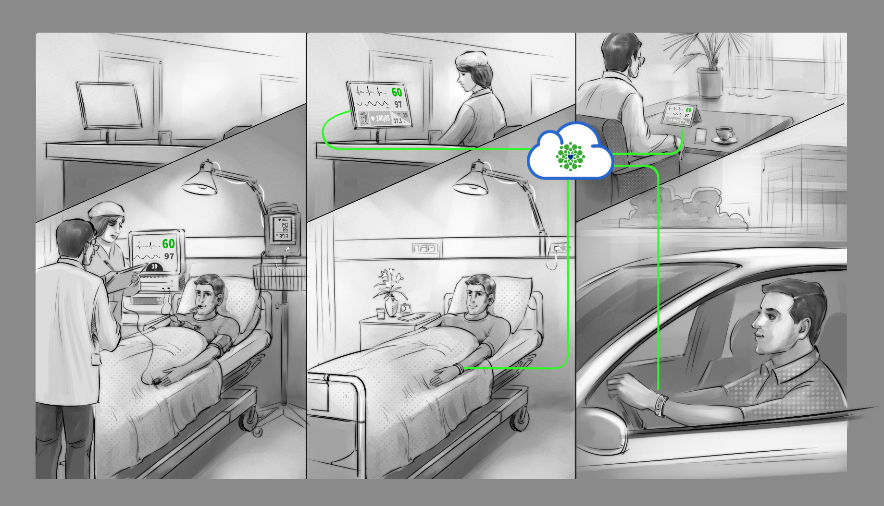
Centralized remote monitoring anywhere, anytime….
31
31

Slide 33
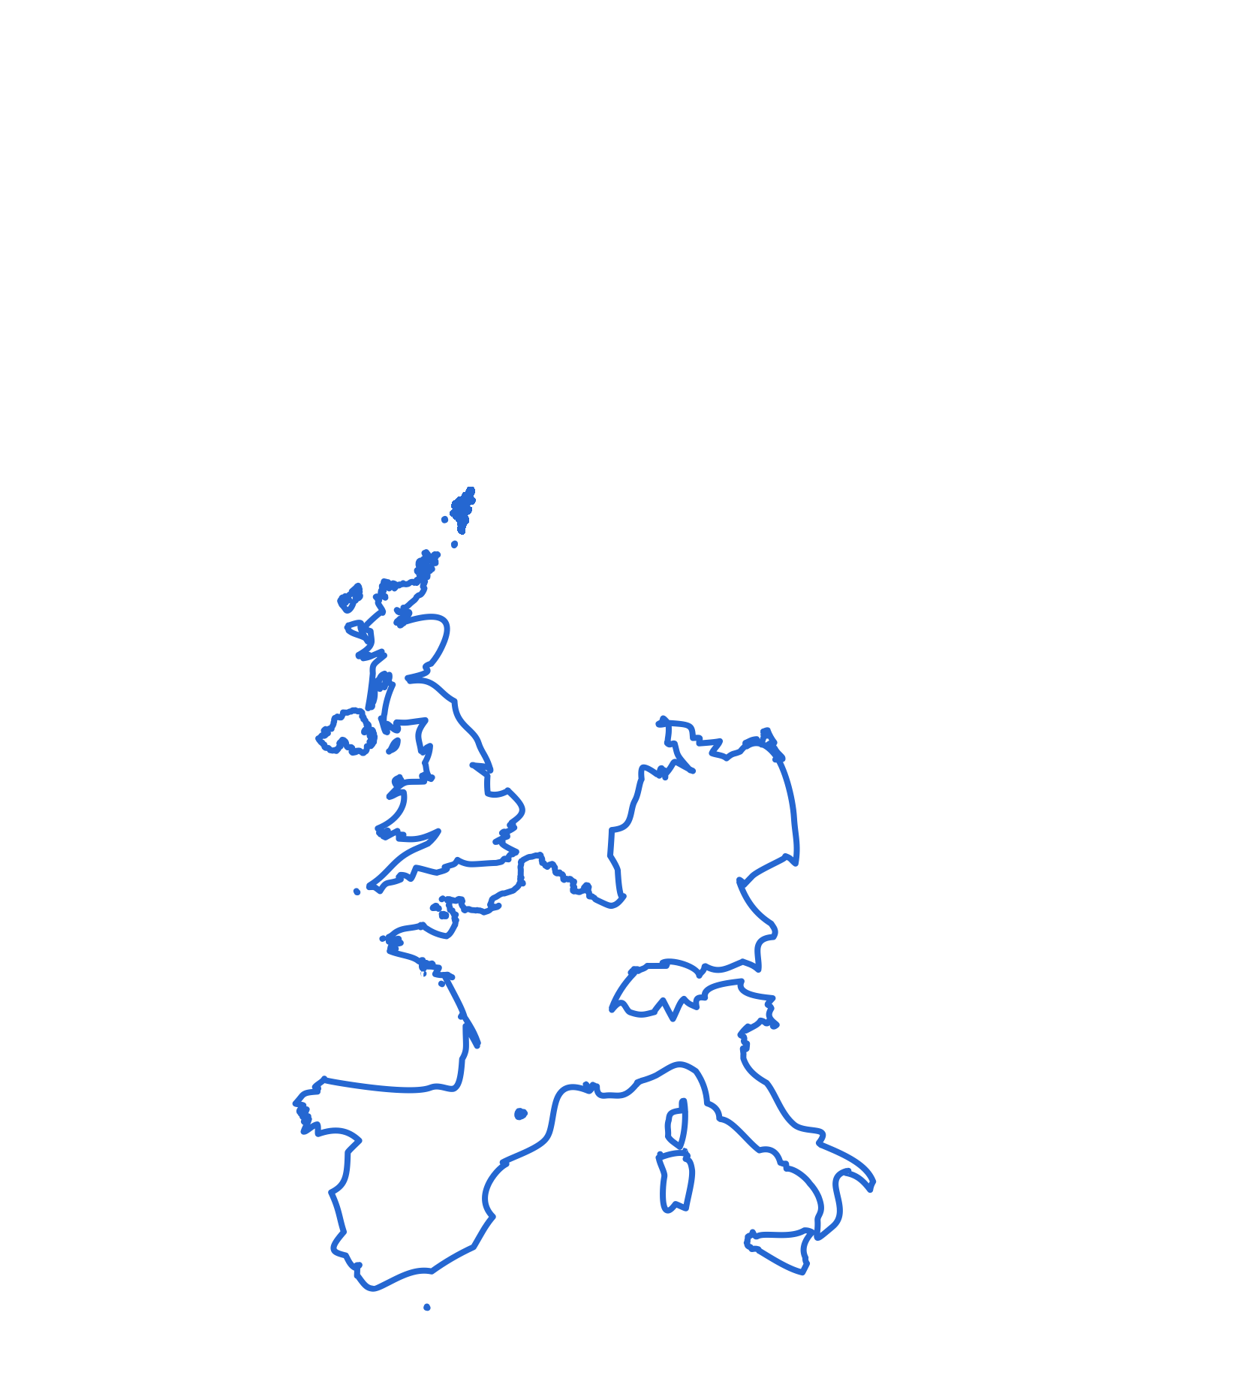

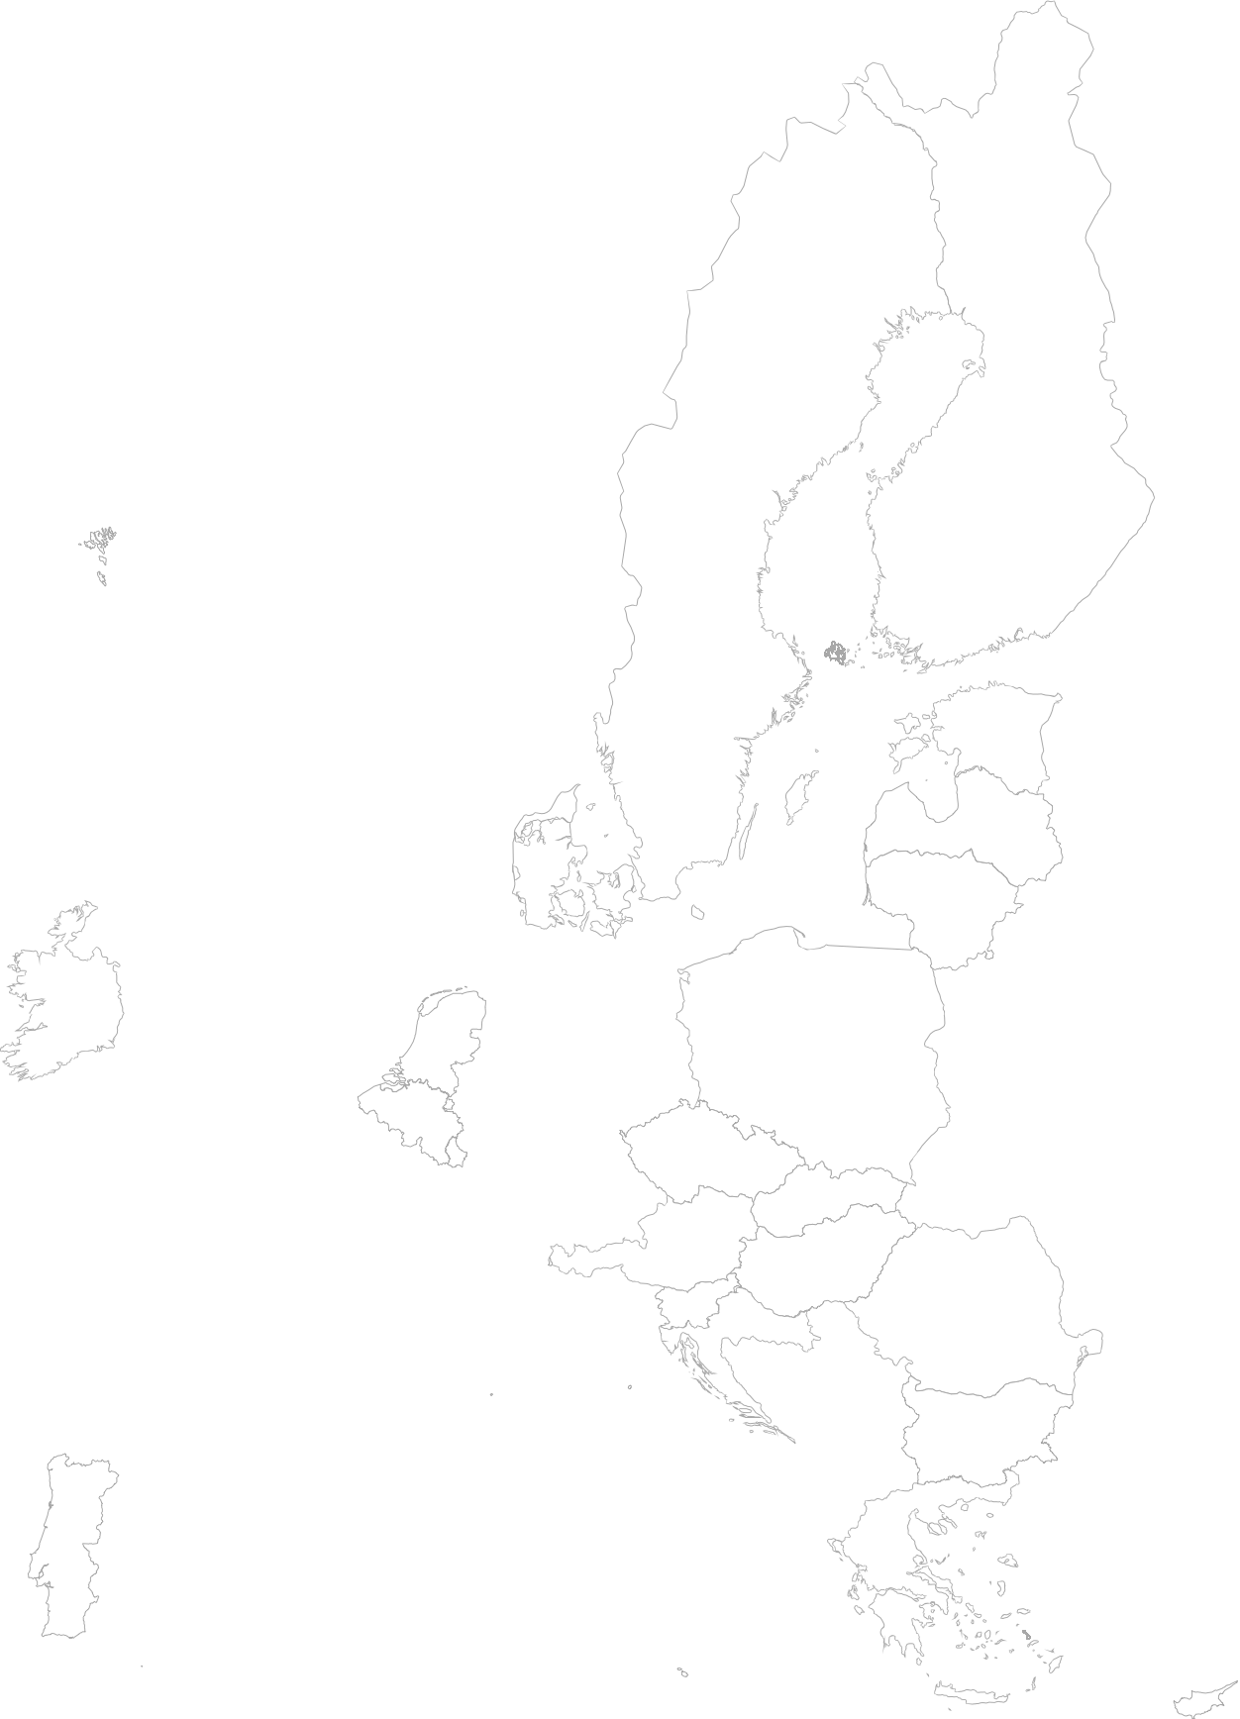



Hypertension is a cardiovascular condition that affects 75 million American adults
Hypertension is a cardiovascular condition that affects 100 million adults across the total EU
46%
Do not have it under control
51
51
$B
20%
€B
Pre-hypertension affects another 75 million American adults
Pre-hypertension affects another 100 million adults across the total EU
Not aware to be having this condition
Market Opportunity
Blood Pressure (BP) Measurement
Hypertension can lead to coronary heart disease, stroke and even death. It is sometimes called the ”SILENT KILLER”
32

Slide 34
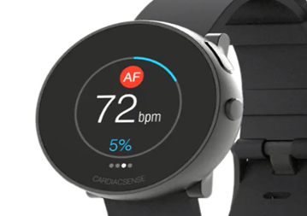
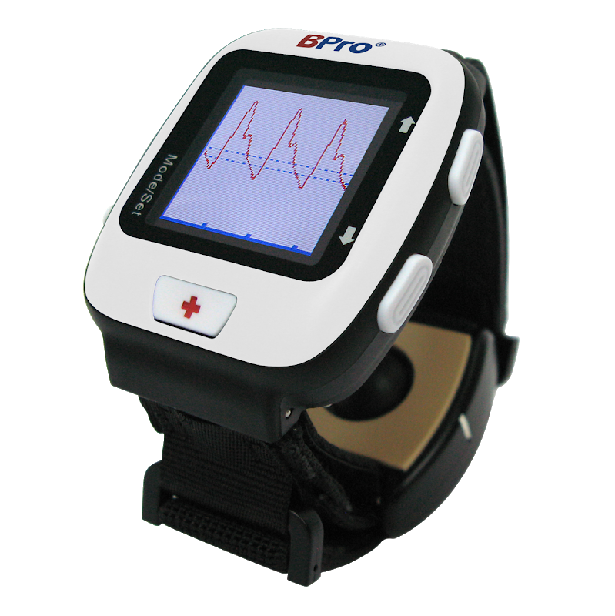
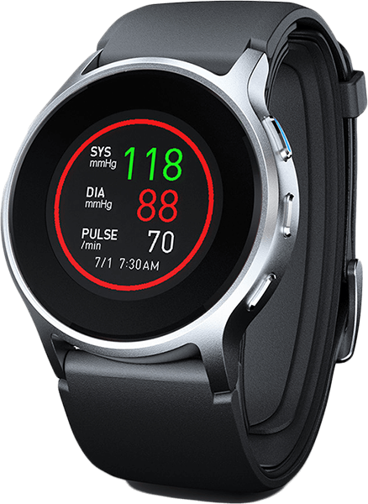
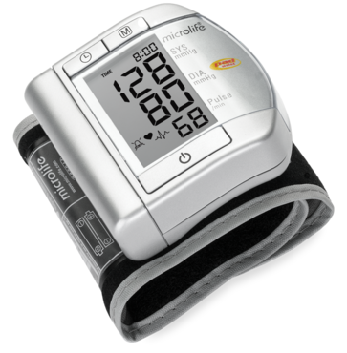
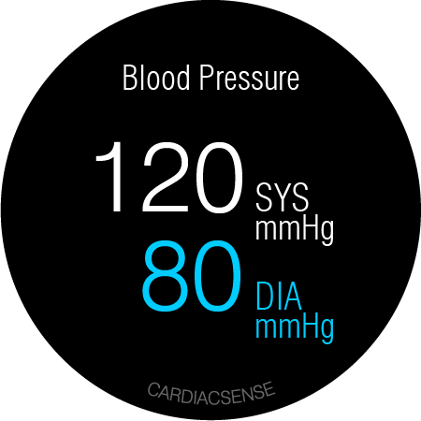
Competition – Absolute Blood Pressure (BP) Measurement
CardiacSense
HealthSTATS Bpro
Omron HeartGuide
Microlife wrist W100
Monitoring duration
Spot-check | Once every 15 min for a full day | Spot-check 30-50 measurements | Spot-check 200 measurements
+++ Non-inflating | ++ Non-inflating | + Inflating cuff inside a watch | - Inflating cuff over the wrist
Heart Arrhythmias, Respiratory Rate, Core Temperature, Oxygen Saturation | -------- | Heart rate | Heart rate
~$700 consumer price before reimbursement | $198 | $500 | $100
Comfort level
Integration with other functionalities
Unit price

Slide 35
Patient reports
Instantaneous Report
Instantaneous Report, Real-time continuous processed data, and raw data (if needed)
Offline data
Hospital Electronic Medical Records Cloud
Real-time data
HIPPA/GDPR Compliant
App and
Cloud Services
Offering
Offline / online data
Online physician such as American Well
CardiacSense Cloud
Offline data
Offline (all raw data)
Offline (Full Disclosure) and real-time (event) data
CardiacSense
Medical Watch Cradle
Monitoring Center Cloud such as Preventice Solutions
Green – Free CardiacSense App
Blue – CardiacSense Cloud Services
Red – 3rd party services

Slide 36


















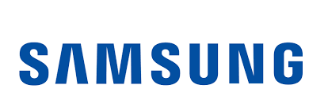








Selected Preliminary Partner Conversations
Cardiac Rhythm Management Device Companies | Other Med Tech / Monitoring Companies
Health Tech / Consumer Tech Companies | Remote Monitoring / Health AI / Pharma Companies
35

Slide 37
Regulatory Milestones – Short term
2020
2021
2022
Q
1
2
3
4
1
2
3
4
1
2
3
4
Beat-by-Beat HR/PR and A-Fib detection by PPG and/or ECG
CE Clearance
Clinical trial for FDA
FDA clearance
NMPA Clearance
Respiratory Rate
Clinical Trial
Submission and CE
Clearance
FDA Clearance
NMPA Clearance
Oxygen Saturation (Finger)
Clinical Trial
Submission and CE
Clearance
FDA Clearance
NMPA Clearance
Tachy, Brady, QT, Pause
Data collection Clinical Trials
Clinical trial for submission
Submission to
CE and FDA
CE and FDA
Clearance
NMPA
Clearance
Oxygen Saturation (continuous over the wrist)
Clinical Trial
Submission to
CE and FDA
CE and FDA
Clearance
NMPA
Clearance
Blood Pressure
Data collection Clinical Trials
Clinical trial for submission
Submission to
CE and FDA
CE and FDA Clearance
NMPA Clearance
Sleep Apnea
Clinical Trial
Submission to
CE and FDA
CE and FDA
Clearance
NMPA
Clearance
Core Temperature
Clinical Trial
Submission to
CE and FDA
CE and FDA
Clearance
NMPA
Clearance
Cardiac Arrest
Clinical Trial
Submission and CE
Clearance
CE and FDA Clearance
NMPA Clearance
36

Slide 38
Regulatory Milestones – Long term, wide clinical trials
2021
2022
2023
Q
1
2
3
4
1
2
3
4
1
2
3
4
CS Vs. Medtronic Reveal for arrhythmia detection
Multi-site clinical trial that includes 300 subjects
Early detection of COPD exacerbation and lowering of hospitalization rate
Multi-site clinical trial that includes 500 subjects
Early detection of Chronic Heart Failure exacerbation and lowering of hospitalization rate
Multi-site clinical trial that includes 500 subjects
Sleep Apnea detection
Multi-site clinical trial that includes 200 subjects
Cardiac Arrest detection and life saving
Multi-site clinical trial that includes 500 subjects
37

Slide 39
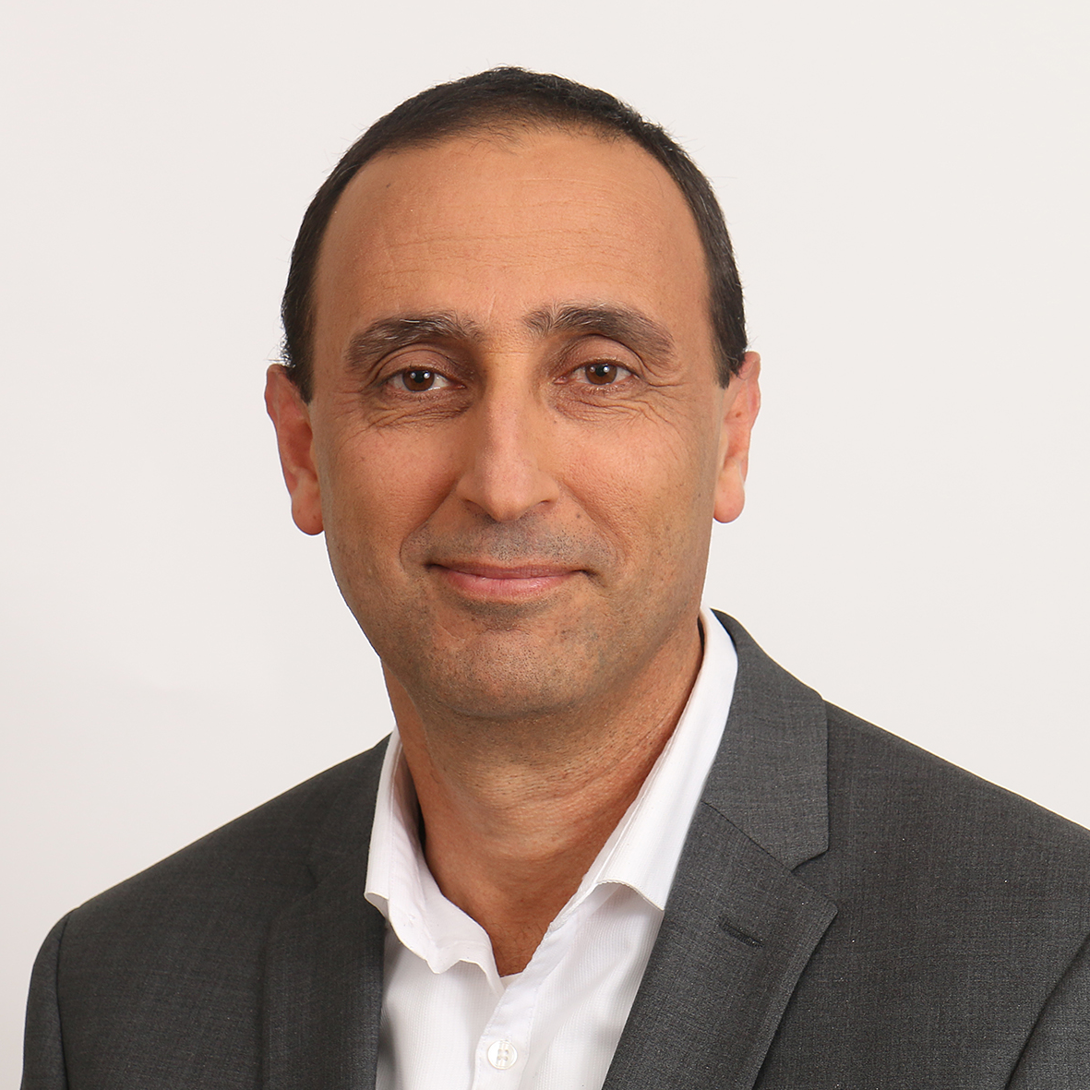
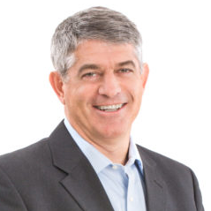

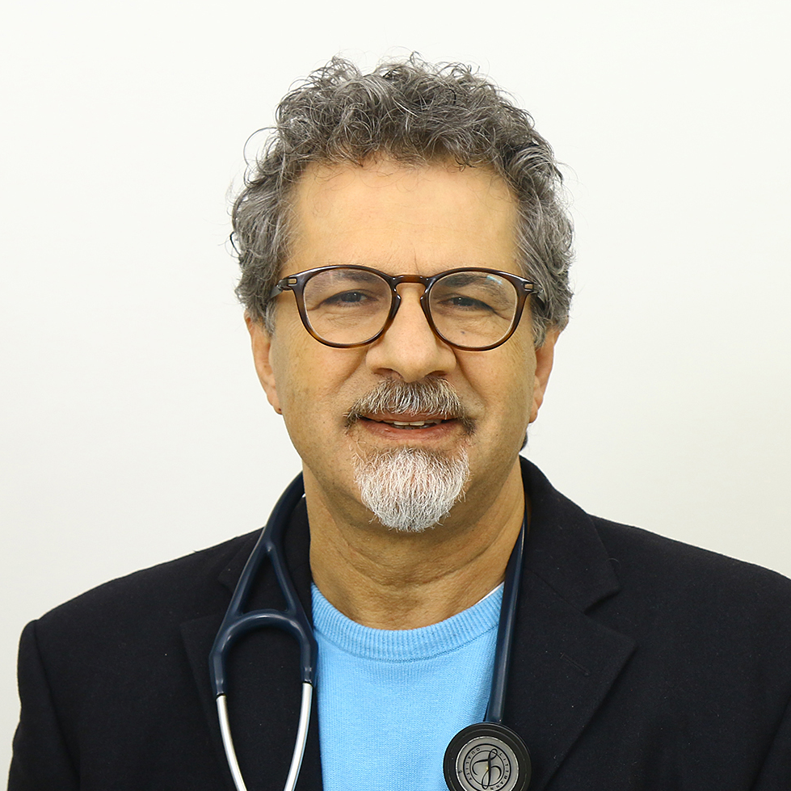




Eldad Shemesh Chief Executive Officer
Daniel Naor Board Director
Former VP Engineering, Spacecom
Former Head of satellite and space systems branch, Israel Air Force
B.Sc., M.Sc. in Electrical & Electronics Engineering, Tel Aviv University
Former McKinsey partner, Europe & North America
PepsiCo senior executive, North America
B.Sc., M.Sc. in Electrical Engineering & Computer Science, M.I.T.
MBA, INSEAD European Business School
Michael Berman Chairman of the Board
Prof. Sami Viskin Chief Medical Officer (Arrhythmia)
Medical device investor/entrepreneur, serving on the boards of 10 emerging medical companies
Former President of the Cardiology business, Boston Scientific
Inducted into Minnesota Business Hall of Fame
BS and MBA, Cornell University
Boston Scientific, Advisory Board
Director, Cardiac Hospitalization, Tel Aviv Medical Center, Israel
Expert on atrial fibrillation
140+ publications in peer reviewed journals
MD, Tel Aviv University, University of California San Francisco
Board & Advisors
Prof. Giris Jacob Chief Medical Officer (Blood Pressure)
Israel Makov Senior Advisor
Director, Internal Medicine, Tel Aviv Medical Center, Israel
MD / PhD, Technion - Israel Institute of Technology
Former President & CEO, Teva Pharmaceuticals
B.Sc. in Agriculture and an M.Sc. in Economics, the Hebrew University in Jerusalem
Prof. Chaim Lotan Senior Advisor
Prof. Boris Spektor Optics Design Leader
Director, Heart Institute, Hadassah - Hebrew University, Jerusalem
Founder and Director, Innovations in Cardiovascular Interventions conference
Former President, Israel Heart Society
MD, Hebrew University of Jerusalem
Stanford University School of Medicine, Sabbatical
Leading 20 electro-optical projects
PhD in Optics from Russian Academy of Sciences, Siberian Branch – Novosibirsk
Senior Scientist and lecturer at the (EE) electrical engineering faculty, Technion, Israel
38

Slide 40
THANK YOU!
Eldad Shemesh, CEO
eldad@CardiacSense.com
+972.54.7000.824

